Slide 2
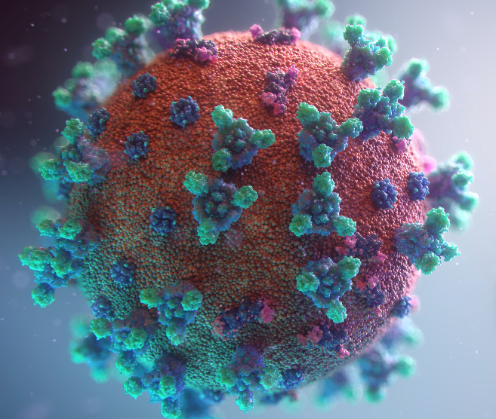
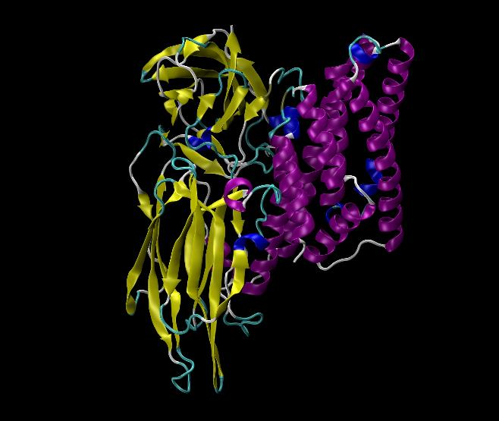
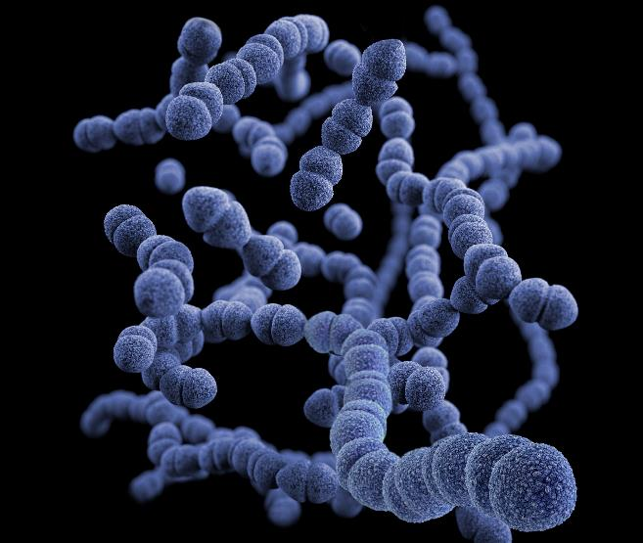
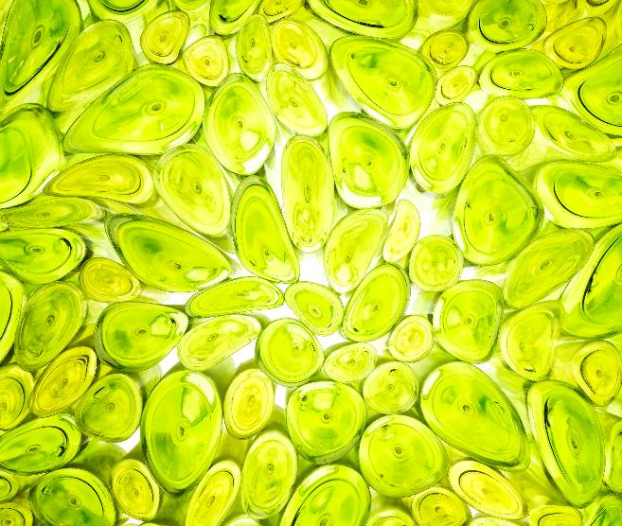
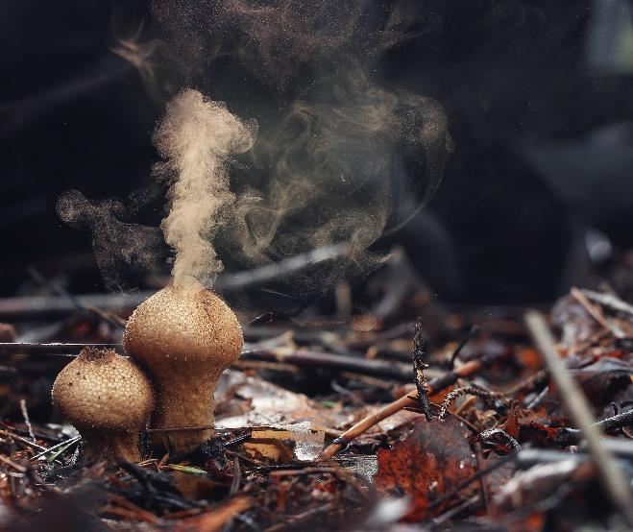
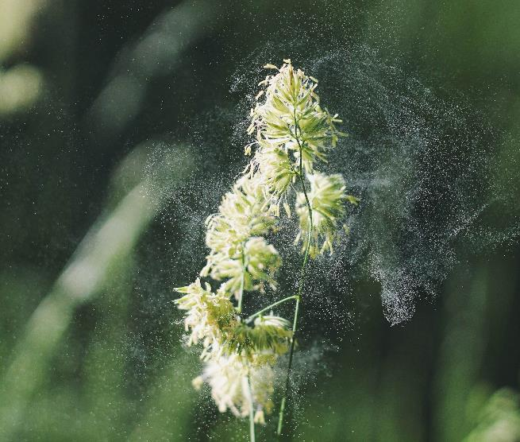
VIRUS
5-300 nm
ENDOTOXIN
1-10 nm
BACTERIA
0.2-10 µm
Can you name these bioaerosols?
PLANT CELLS
20-40 µm
FUNGI AND SPORES
1-100 µm
POLLEN
10-100 µm

Slide 3
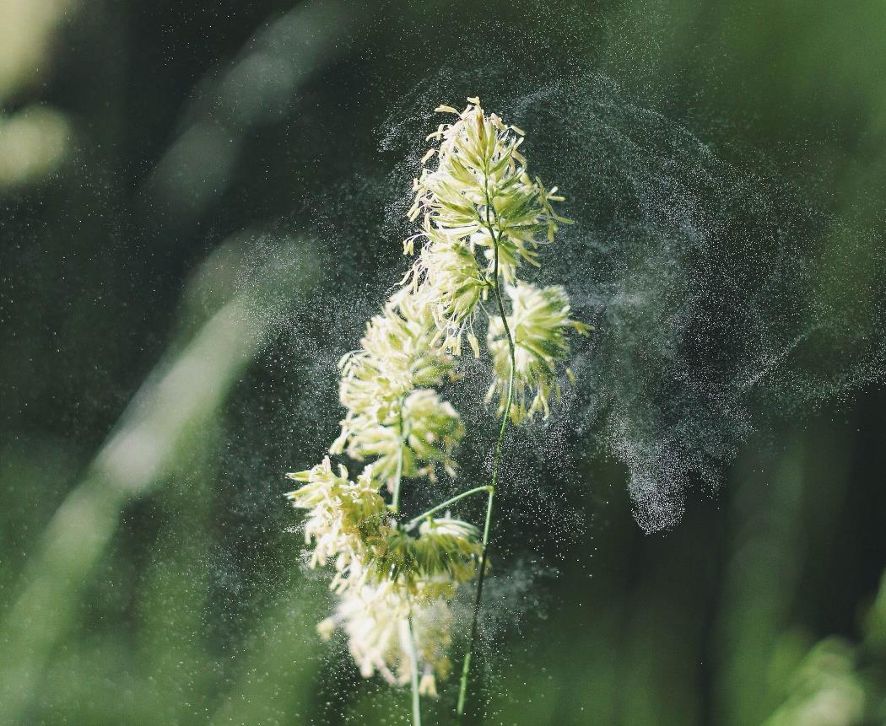
Bioaerosols play a major role in environmental processes (climate, ecosystems) and human health.
They vary widely in size, shape, structure and composition:
ranging from nanometres (nm) to tens of micrometres (μm) in size
and including whole organisms, single cells (dead or alive), cell fragments and spores.
Unsplash: Alex Jones

Slide 4
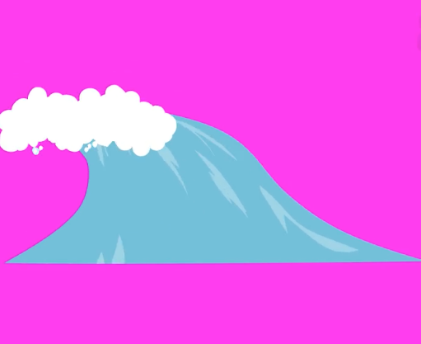
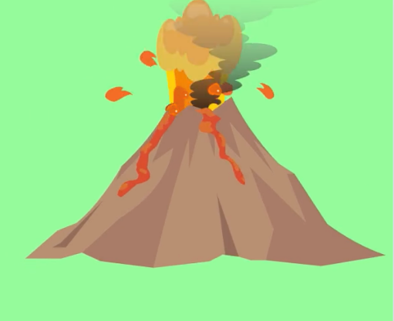
The size, shape, structure and composition of bioaerosols depend on:
Their source (natural or anthropogenic)
How they were formed (particle or droplet)
Which images on the right represent natural sources of bioaerosols, and which are anthropogenic?

Slide 5
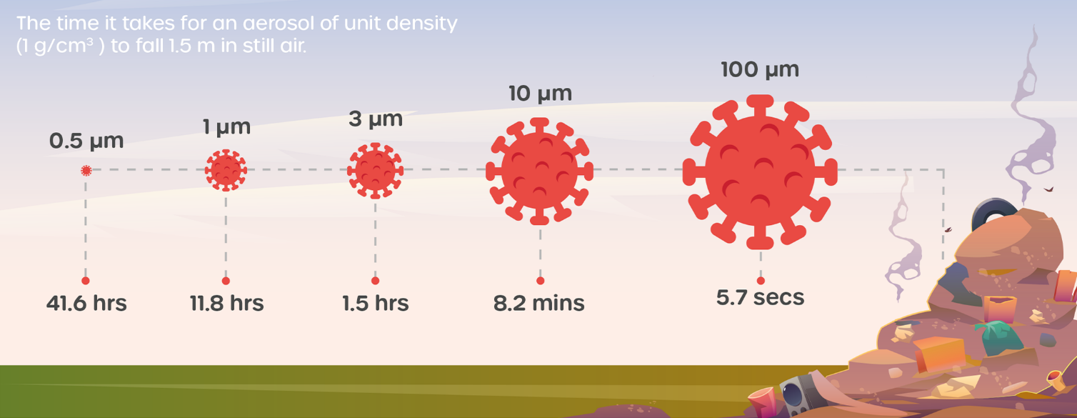
The composition and size of bioaerosols will determine their behaviour, dispersal, transformation and, ultimately, their environmental and public health impact.

Slide 6
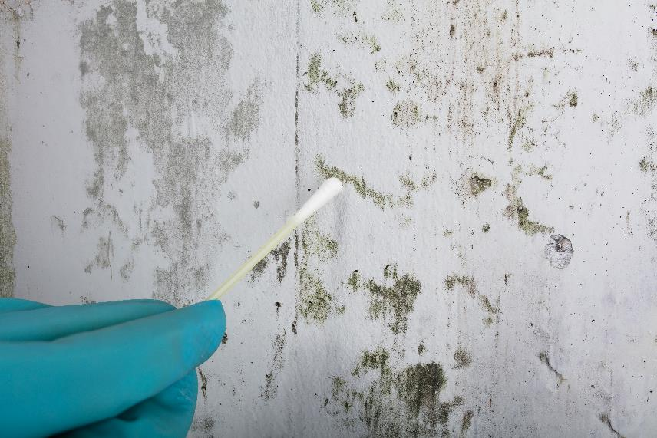
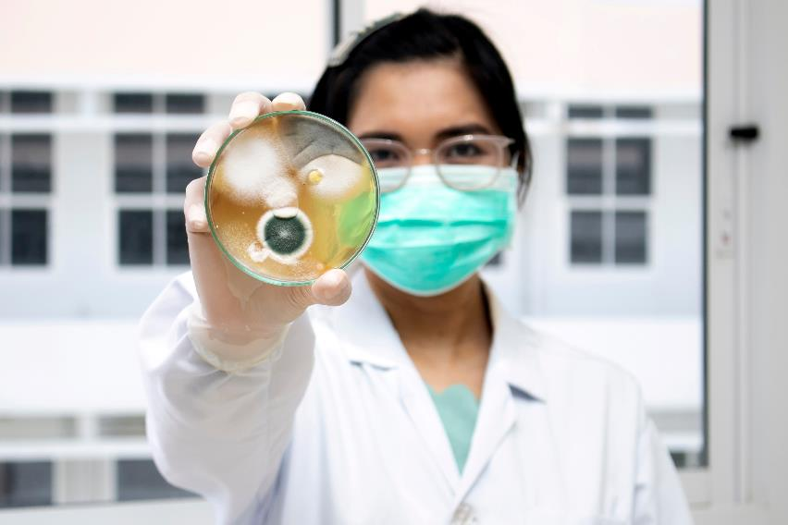
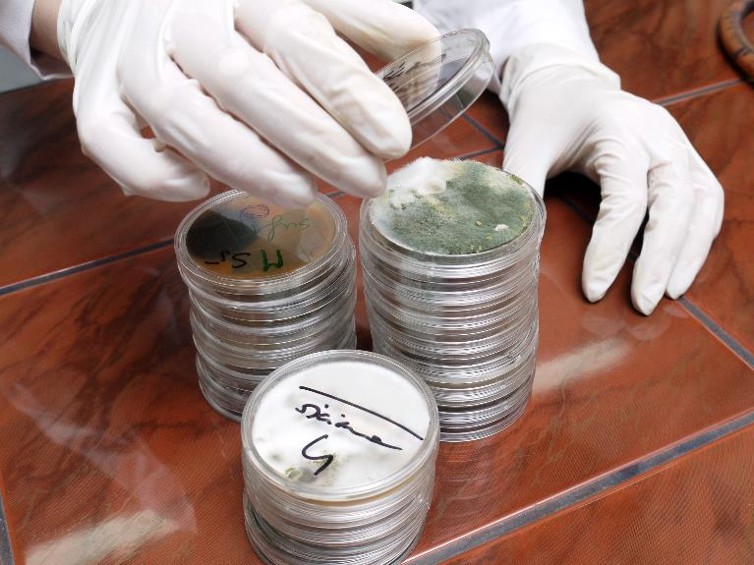
This is why it is important to sample, quantify and analyse bioaerosols.
Andrey Popov/stock.adobe.com
Settapong/stock.adobe.com
Roman Milert/stock.adobe.com

Slide 7
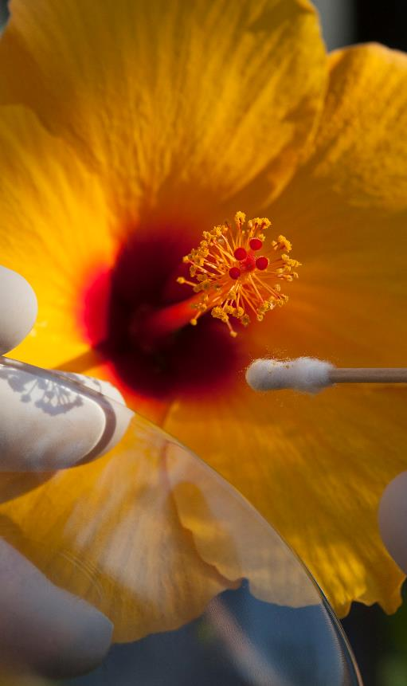
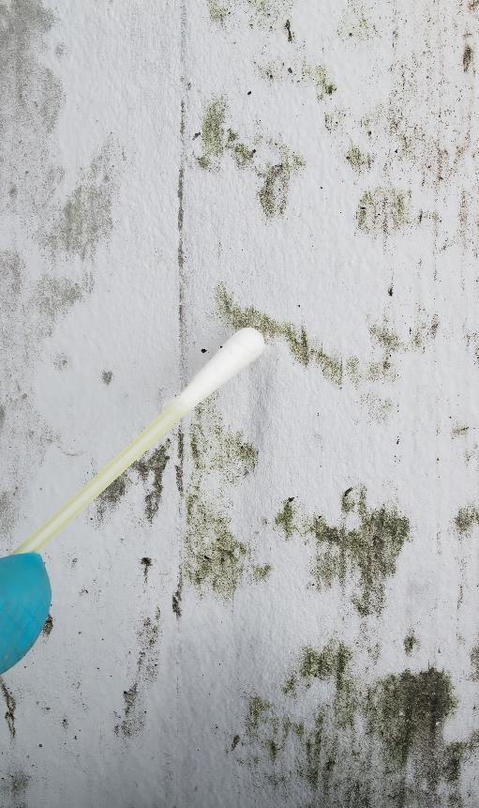
By sampling, quantifying and analysing bioaerosols, it is possible to characterise their nature, viability, size and composition in different environments (e.g., indoors and outdoors).
Viability is the capacity of a living organism to stay alive, and sustain its life, growth, and development.
Sampling, quantifying and analysing bioaerosols is necessary to better understand their environmental and public health impacts.
JimmyC/stock.adobe.com
Andrey Popov/stock.adobe.com

Slide 8
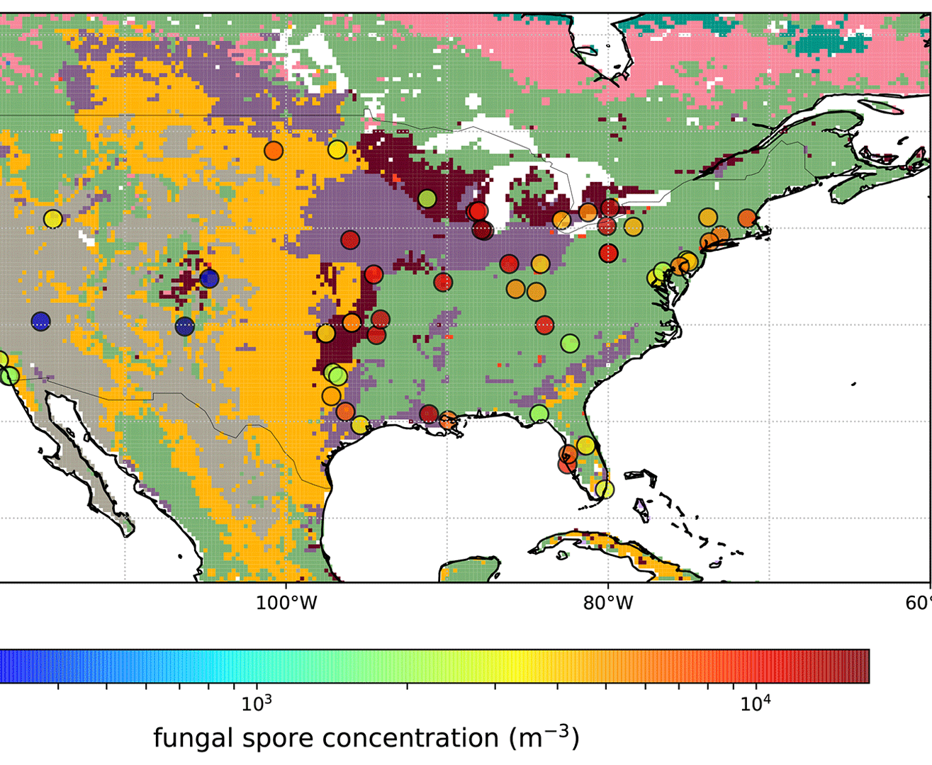
This knowledge can also be used to design and evaluate the effectiveness of different control and intervention strategies…
and to develop numerical models for studying the environmental and human health impacts of bioaerosols.
Average observed fungal spore concentrations over the period 2003–2008 for all AAAAI stations (circles) shown
on top of lumped land use classes bases on the Olson World Ecosystems (Olson et al., 2001. Janssen, R. H. H., Heald,
C. L., Steiner, A. L., Perring, A. E., Huffman, J. A., Robinson, E. S., Twohy, C. H., and Ziemba, L. D.: Drivers of the fungal
spore bioaerosol budget: observational analysis and global modeling, Atmos. Chem. Phys., 21, 4381–4401,
https://doi.org/10.5194/acp-21-4381-2021, 2021.

Slide 9
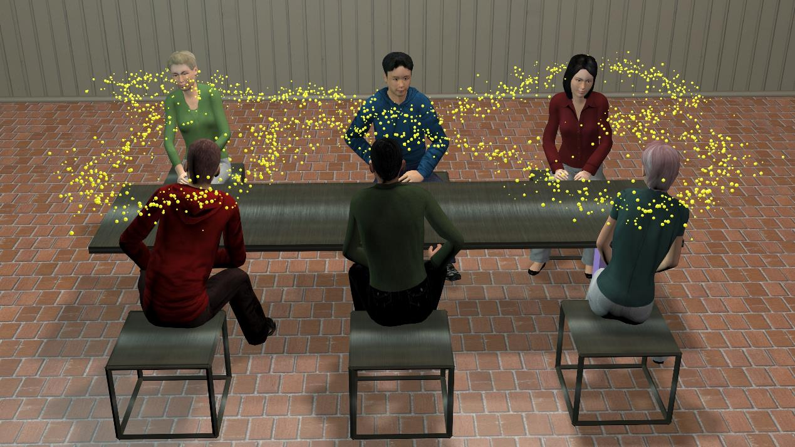
SAMPLING
Vrx123/adobe.stock.com
Sampling involves the collection of bioaerosols from the air and placing them in or on a surface so that they can be studied.
By sampling, researchers can collect bioaerosols to study their identities and concentrations in different environments.

Slide 10
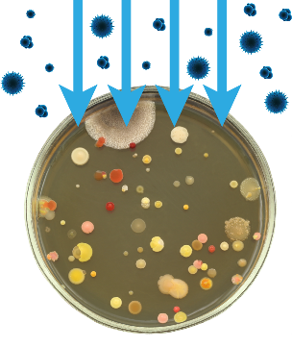
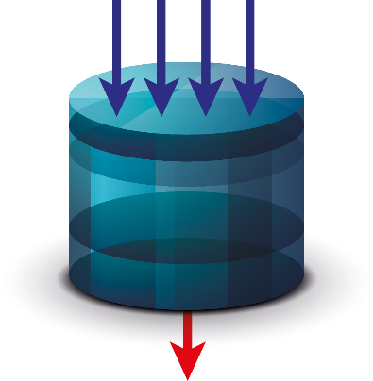
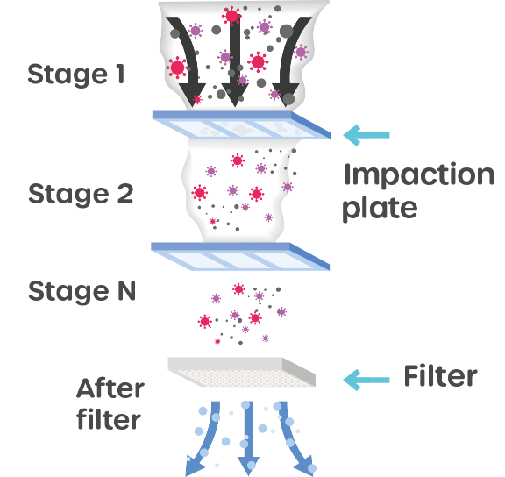
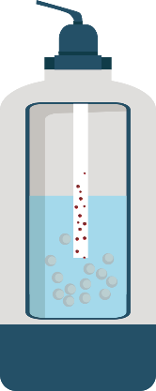
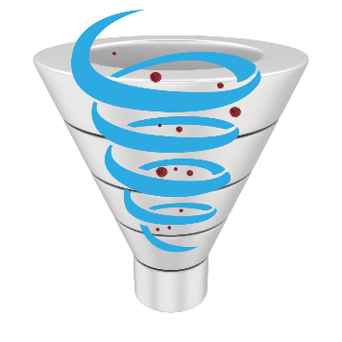
What are the different
sampling methods?
A range of sampling and collection methods are available for bioaerosols.
The most frequently used collection methods are gravitation, impaction, impingement, filtration and cyclone sampling.

Slide 11
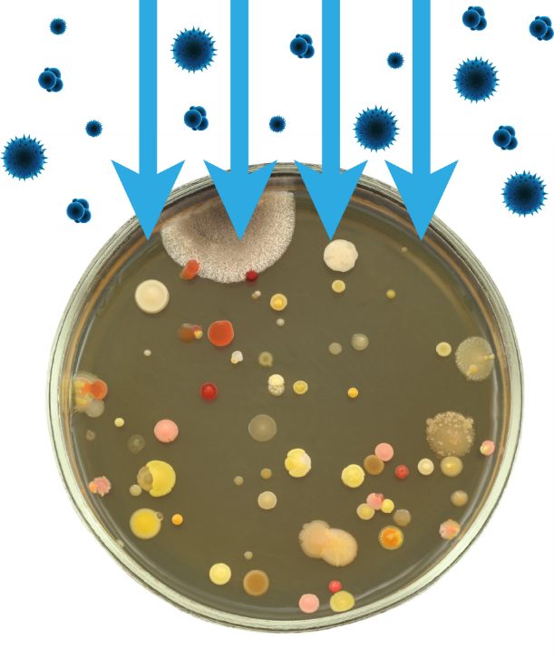
Gravitation
Settling by gravitation onto a surface
Gravitation is the movement due to gravity, such as falling bioaerosols settling onto surfaces.
Gravitation relies on bioaerosols settling on a collection surface, such as a culture plate, foil sheet, cloth or filter.

Slide 12
Impaction
Impacting the sample onto a surface
This relies on the inertial impaction of particles onto a collection surface.
Air is pumped through the sampler and bioaerosols of varying sizes impact onto a collection surface, depending on their inertia.
To learn more about inertia, visit:
www.bbc.co.uk/bitesize/guides/z8crsrd/revision/9

Slide 13
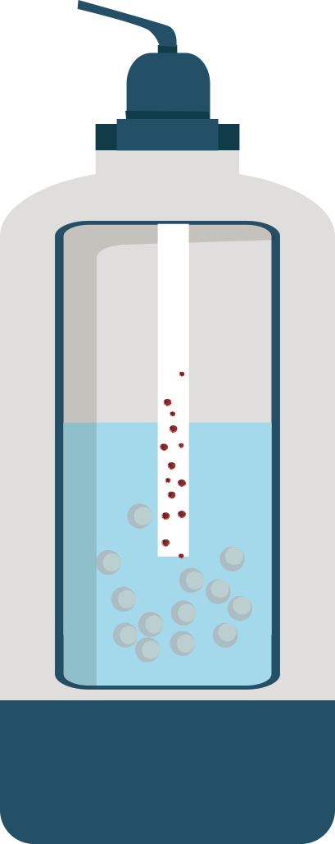
Impingement
Collecting the sample in a liquid
This involves collecting bioaerosols by bubbling air through a collection fluid.
Air flows down the sampler and bioaerosols are collected as they disperse through the liquid in the sampler.

Slide 14
Filtration
Collecting the sample in a filter
Filtration involves collecting bioaerosols onto a porous material, usually a filter.
Air is pumped through the filter, which captures bioaerosols.

Slide 15
Cyclone
Using centrifugal forces to collect bioaerosols
Cyclone samplers collect bioaerosols in a dry or wet (filled with liquid) vessel.
Air is pumped through the sampler and, depending on inertia, bioaerosols are deposited in the vessel.
To learn more about centrifugal forces, see:
https://en.wikipedia.org/wiki/Centrifugal_force

Slide 16
The choice of sampling method depends on many factors, for example:
Aim of sampling
Bioaerosol of interest
Expected concentration
Sampling sites
Sampling duration
Sample volume
Analysis methods

Slide 17
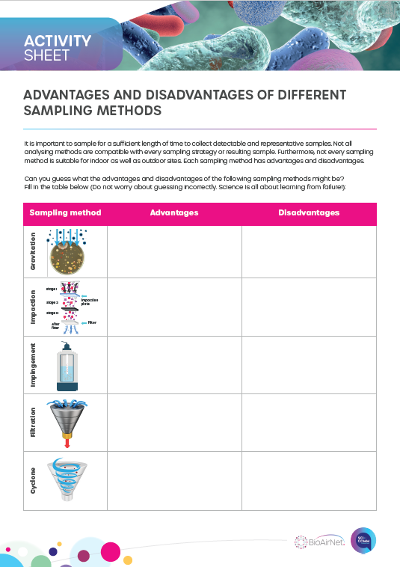
Activity 1
Can you guess what the advantages and disadvantages of different sampling methods might be?
Fill in the table.

Slide 18
Advantages and disadvantages of different sampling methods
Sampling method | Advantages | Disadvantages
Gravitation | Ease of use Large numbers of samples can be taken Low cost | Relies on air current Larger sized particles are more likely to be collected because they settle quicker than smaller particles
Impaction | Ease of use Direct collection onto collection surfaces (culture plates, etc.) Researchers can choose different impaction surfaces depending on their analysis needs | Collection surfaces can be overloaded with bioaerosols Loss of viability – cells can end up dying due to loss of moisture (desiccation) or strong air flow Bioaerosols may bounce and not impact onto the collection surface
Impingement | Collected bioaerosols are more likely to survive Less physical stress on the collected bioaerosols | If the sampling takes a long time, some of the liquid might be lost due to evaporation The sampler needs to be sterilised after each sample has been collected
Filtration | Ease of use Easy to sterilise and transport Suitable for long sampling periods Researchers can choose different types of filter depending on their analysis needs | Loss of viability – cells can end up dying due to loss of moisture (desiccation) or strong air flow The collection can be labour intensive
Cyclone | Large numbers of bioaerosols can be collected A large volume of air can be sampled Easy to sterilise and transport | With the wet cyclone, there is a risk of a loss of collection liquid With the dry cyclone, cells can end up dying due to loss of moisture (desiccation) or strong air flow

Slide 19
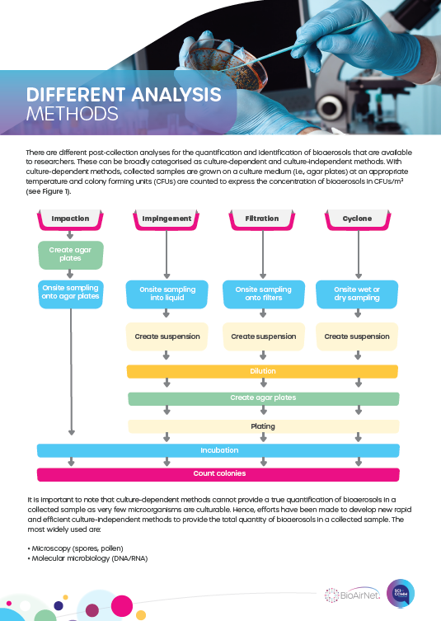
Activity 2
Read the handout:

Slide 20
Activity 3
Design a poster to explain a sampling strategy for investigating indoor fungi in your home or school. Include:
The best sampling and analysis method
Number of samples to be taken
Duration of sampling
Prostock-studio/adobe.stock.com

Slide 21
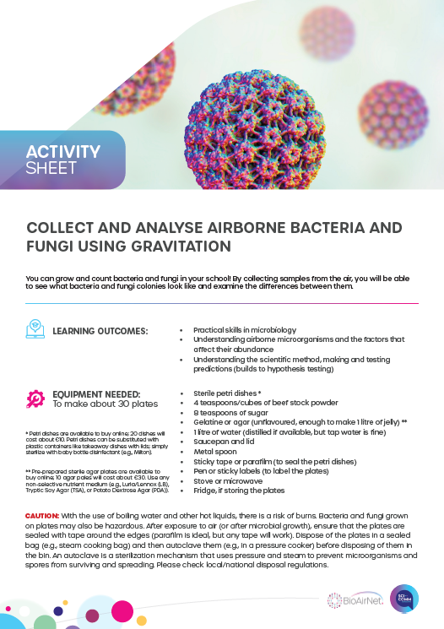
Activity 4
Follow the instructions to collect and analyse airborne bacteria and fungi using gravitation:

