Slide 2
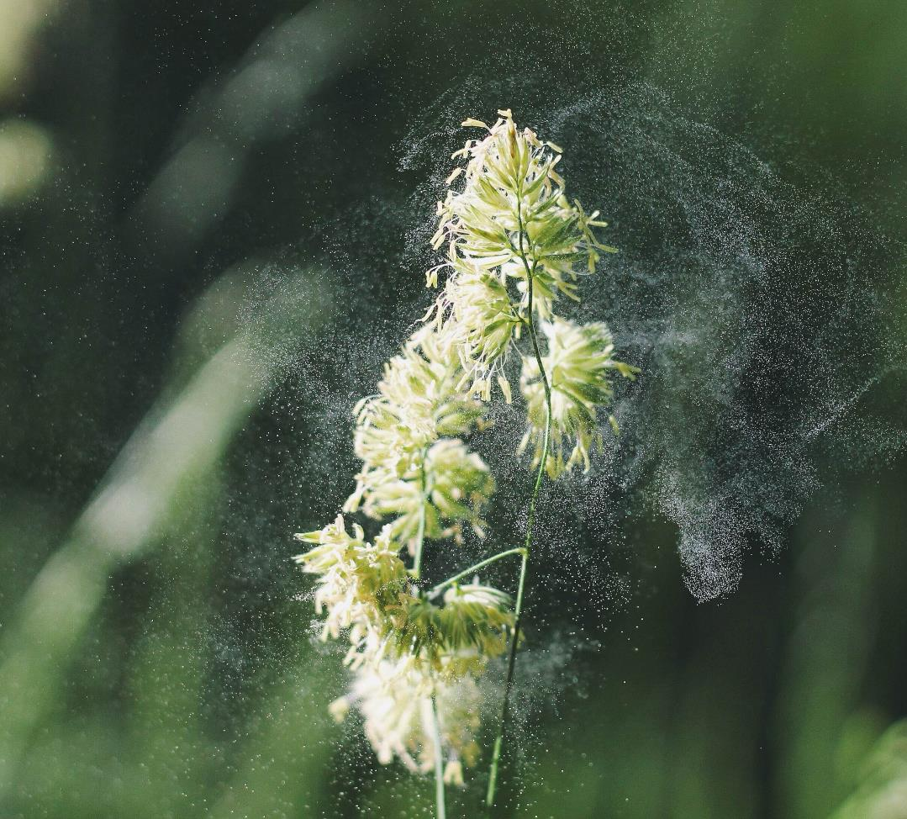
To recap…
Although exposure to bioaerosols can have positive effects, some particles present a hazard, which can cause adverse health effects in some individuals.
What are the positive effects of exposure to bioaerosols?
And what are the potential negative effects?
Unsplash: Alex Jones

Slide 3
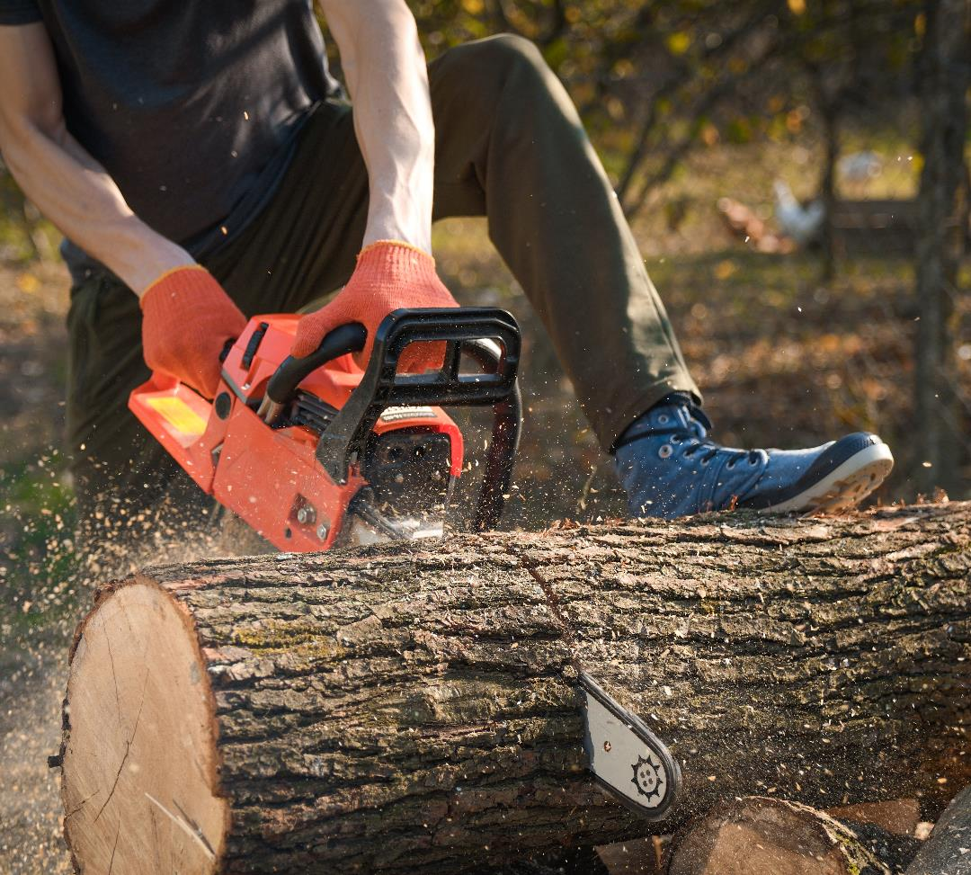
Hazard, risk and exposure
A hazard is anything that can cause harm. For example, a chainsaw is a hazard. It is always a hazard, in that it can always cause harm.
A risk, however, is the likelihood that the hazard will cause harm.
A hazard only becomes a risk when someone is exposed to that hazard.
Ivan/stock.adobe.com

Slide 4
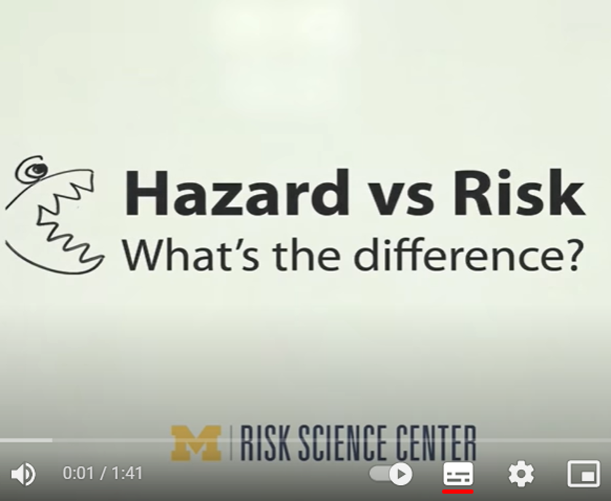
Activity 1
Watch this YouTube video:
Hazard vs Risk What’s the difference?

Slide 5
How do we get from hazard to risk?
When dealing with hazards, the risk of harm occurring from that hazard only occurs under conditions of ‘exposure’.
This means that there must be a route between the hazard and people in order for the hazard to present a risk.

Slide 6
An example of low risk…
A person with flu may cough and this will produce bioaerosols that contain hundreds to thousands of flu virus particles (the hazard).
If the sick person coughs in a room where no-one else is, then no-one else has been exposed to the flu virus and risk of anyone else getting sick is LOW.
Stratford Productions/stock.adobe.com

Slide 7
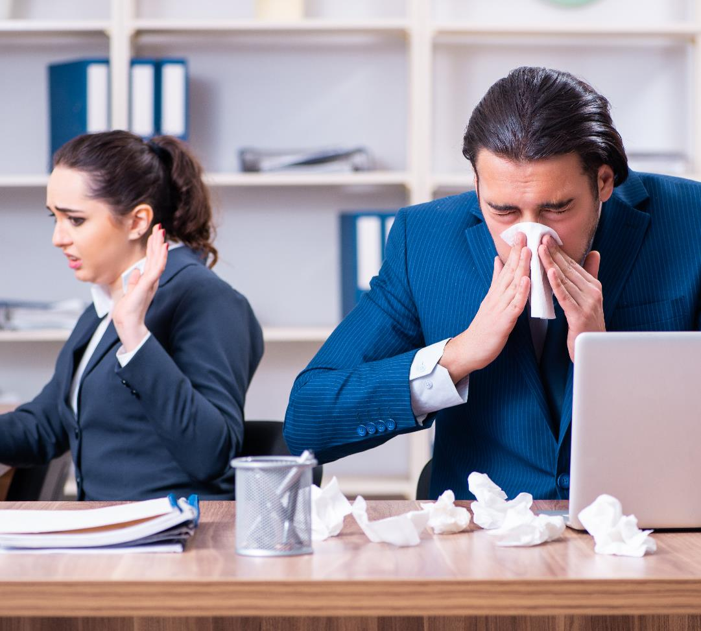
An example of high risk…
If a healthy person is in the room when the sick person coughs then the healthy person has been exposed to the flu virus.
This does not automatically mean the healthy person will get sick but the risk of them getting sick is HIGHER because they have been exposed to the hazard (the flu virus).
Elnur/stock.adobe.com

Slide 8
What does ‘exposure’ mean?
Exposure means: ‘experiencing something or being affected by it because of being in a particular situation or place’.
If there is no exposure, then the risk is LOW.
If there is exposure, then the risk is HIGHER.

Slide 9
Hazard
+
Exposure
=
Risk

Slide 10
Activity 2
Think of a scenario that presents a risk. What is the hazard? What is the exposure?
Like the image of a shark, draw a picture to present your scenario.
Prostock-studio/stock.adobe.com

Slide 11
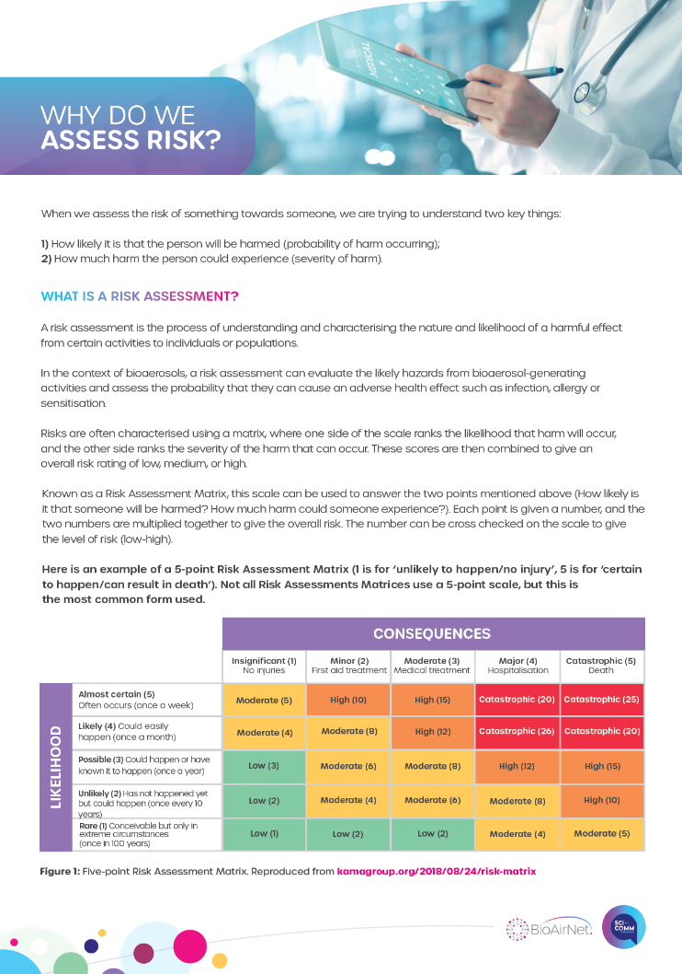
Activity 3
Read the handout:
Why do we assess risk?

Slide 12
Activity 4
Risk | Mitigating Action
What are the three risks associated with bioaerosols?

Slide 13
Activity 4
Risk | Action
Infection
Allergy
Sensitisation
Infection, allergy and sensitisation are the three risks associated with bioaerosols.
Now identify actions to reduce these risks.

Slide 14
Risk | Action
Infection from bioaerosols containing microbes (i.e., an infected person sneezes or coughs) | Wear a face mask/covering Wash hands frequently Communicate the risk (i.e. ‘catch it, kill it, bin it’)
Allergy from bioaerosols containing allergens such as pollen or fungi | Stay indoors (if allergens are outside) Close windows and doors (if allergens are outside) Open windows and doors (if allergens are inside) Communicate the risk
Sensitisation to the material in bioaerosols | Reduce exposure to bioaerosols containing sensitising material Communicate the risk

Slide 15
Activity 4
You may have come up with more actions to reduce risk. In groups or with a partner, discuss the practicality of your actions.
Barry Barnes/stock.adobe.com

Slide 16
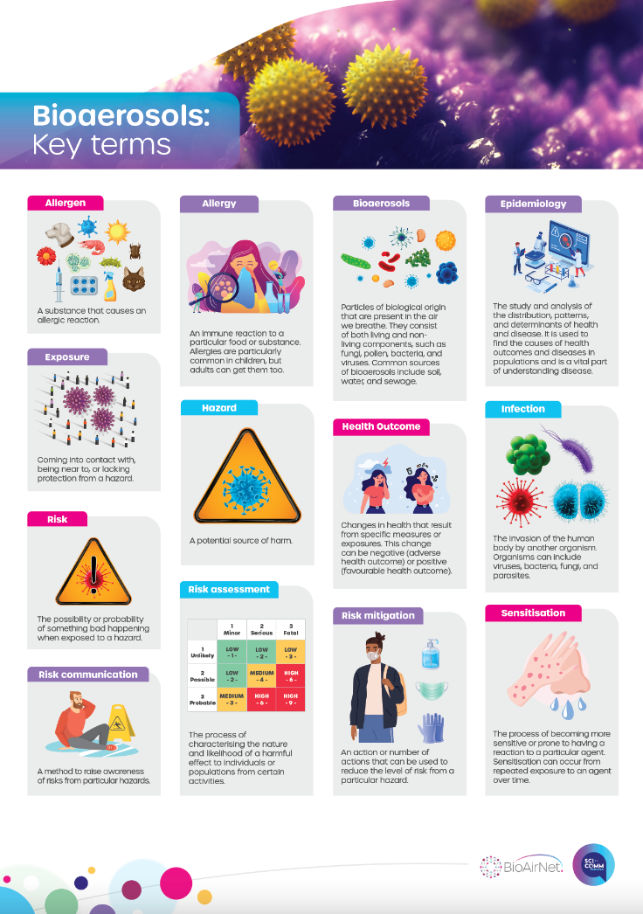
Activity 5
Indoor allergen | Action | Outdoor allergen | Action
Look at the poster of Key Terms.
What is an allergen?
Can you think of indoor and outdoor allergens?
What actions could be taken to reduce the risk of allergy from indoor and outdoor allergens?

Slide 17
Indoor allergens | Action | Outdoor allergens | Action
Dust mites | Vacuum and clean regularly; replace carpets with wooden flooring, tiles or linoleum; regularly wash bedding | Pollen | Stay indoors when pollen counts are high; keep windows closed; take allergy medication; keep informed and take heed of risk communication and public information campaigns
Pet dander | Keep pets away from bedrooms and other living areas; vacuum and clean regularly; communicate risk to visitors | Fungi spores | Stay indoors when spore counts are high; keep windows closed; take allergy medication; keep informed and take heed of risk communication and public information campaigns
Mould | Make sure rooms are well ventilated; fix the damp source; clean mould on walls and other surfaces

Slide 18
Plenary
1. What did you already know before this session?
2. List three new things you have learned.
3. Which piece of information surprises you the most and why?
4. In what way has this session changed the way you see the world?

