Slide 2
What is ‘risk communication’?
Quite often, the simplest action to reduce risk is communication.
Simply making people more aware of the risks can make them change their behaviour to avoid being hurt.
pavel_shishkin/stock.adobe.com

Slide 3
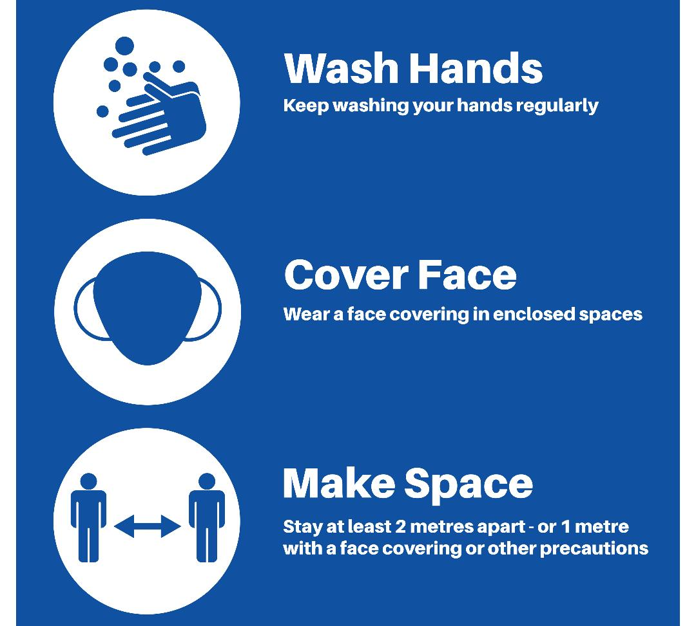
COVID-19
Risk communication can be used to let individuals know what actions they can take to protect themselves.
A good example is the COVID-19 risk communication campaign: ‘Hands, Face, Space’.
Using a very simple slogan, this campaign was not only able to make people aware that COVID-19 posed a risk, but that three actions can be done to keep people safe.
Vector Archive/stock.adobe.com

Slide 4
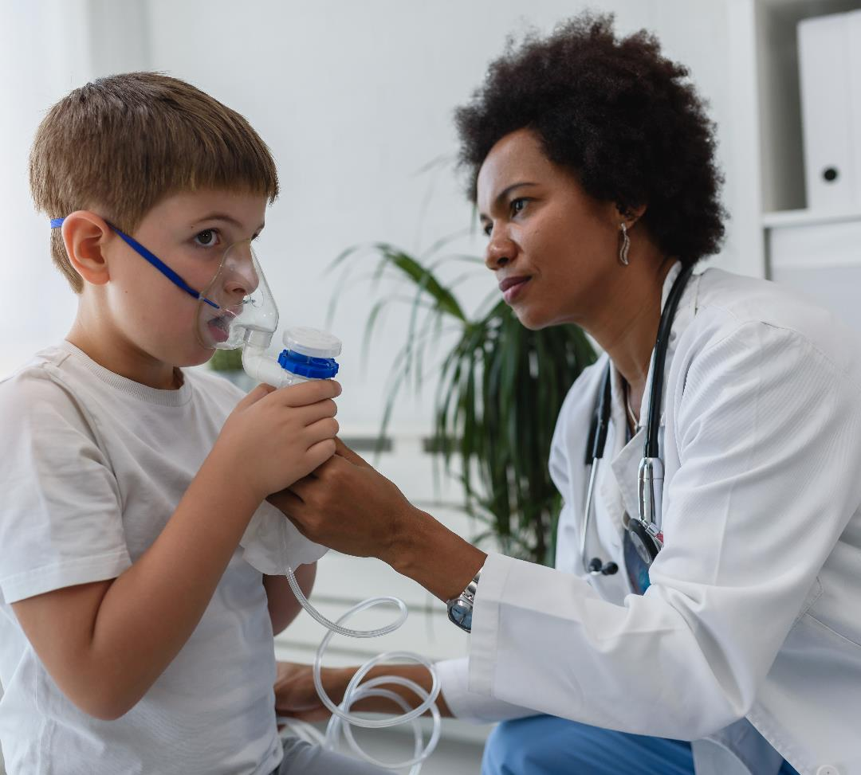
Effectively communicating risk
To be effective, the messages used in risk communication need to be simple and easy to remember – and they must not scare people.
They must also be targeted at the right people.
For example, if asthmatics are more at risk from flu, then it is vital that they receive the messages about this risk.
lordn/stock.adobe.com

Slide 5
Activity 1
In your own words, define ‘risk communication’.
Explain how communication can reduce risk.
Give an example of a campaign that has successfully communicated risks.
What actions were taken?
Prostock-studio/stock.adobe.com

Slide 6
Activity 1
Think back to the lesson on risk, hazard and exposure.
How might the risk of a shark attack be communicated?

Slide 7
Key questions
What key questions need to be answered before a risk communication campaign can be designed?
Four key questions are:
What is the key message we need to communicate?
Who do we need to communicate it to?
When do we need to communicate it?
Is there a key time, e.g., just before grass pollen season?
4. How do we communicate it? What form of communication should be used (e.g., social media, posters) and where (e.g., health centres)?

Slide 8
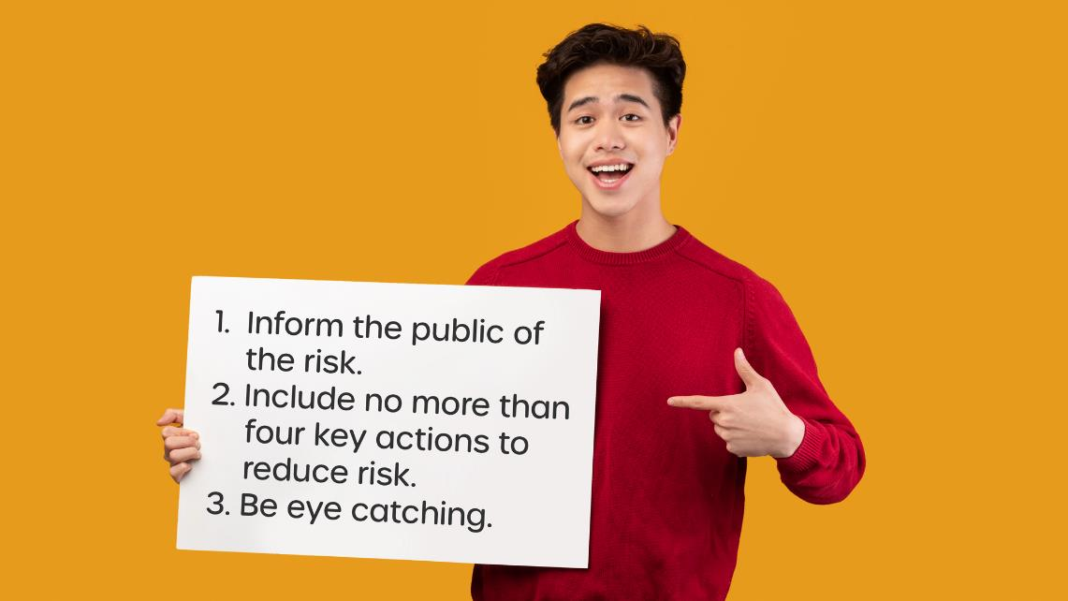
Activity 2
Design a public information campaign to raise awareness of one of the key risks from bioaerosols.
Your poster should:

