Slide 2
The source-pathway-receptor (SPR) model
Source:
Person with COVID-19 coughing
The SPR model allows us to simulate the ways that people can become exposed to a hazard.
It can be used as a tool to model potential scenarios, or it can be used to assess hazard and exposure in an incident that is ongoing or has happened.
Pathway:
Air (via bioaerosols in the air after coughing)
Pathway:
Surfaces (via droplets landing on surfaces from coughing
Receptor:
People within
2 m of source
Receptor:
People who touch recently contaminated surfaces
Source-Pathway-Receptor model using COVID-19 as an example

Slide 3
In this model…
Source:
Person with COVID-19 coughing
The source is the hazard, the object or substance that can cause harm.
The pathway is the route of exposure, the way that the source reaches the receptor.
The receptors are anyone or anything that can be affected or harmed by the hazard (includes people but may also include the environment and animals).
Pathway:
Air (via bioaerosols in the air after coughing)
Pathway:
Surfaces (via droplets landing on surfaces from coughing
Receptor:
People within
2 m of source
Receptor:
People who touch recently contaminated surfaces
Source-Pathway-Receptor model using COVID-19 as an example

Slide 4
To reduce the risk of harm…
Source:
Person with COVID-19 coughing
Source:
Person with COVID-19 coughing
We need to break the link.
This is done by either removing the source (e.g., the COVID-19 particles or the person coughing)…
…removing the pathway (bioaerosols or droplets deposited on surfaces)…
or removing the receptor (people).
Pathway:
Air (via bioaerosols in the air after coughing)
Pathway:
Surfaces (via droplets landing on surfaces from coughing
Pathway:
Air (via bioaerosols in the air after coughing)
Pathway:
Surfaces (via droplets landing on surfaces from coughing
Receptor:
People within
2 m of source
Receptor:
People within
2 m of source
Receptor:
People who touch recently contaminated surfaces
Receptor:
People who touch recently contaminated surfaces

Slide 5
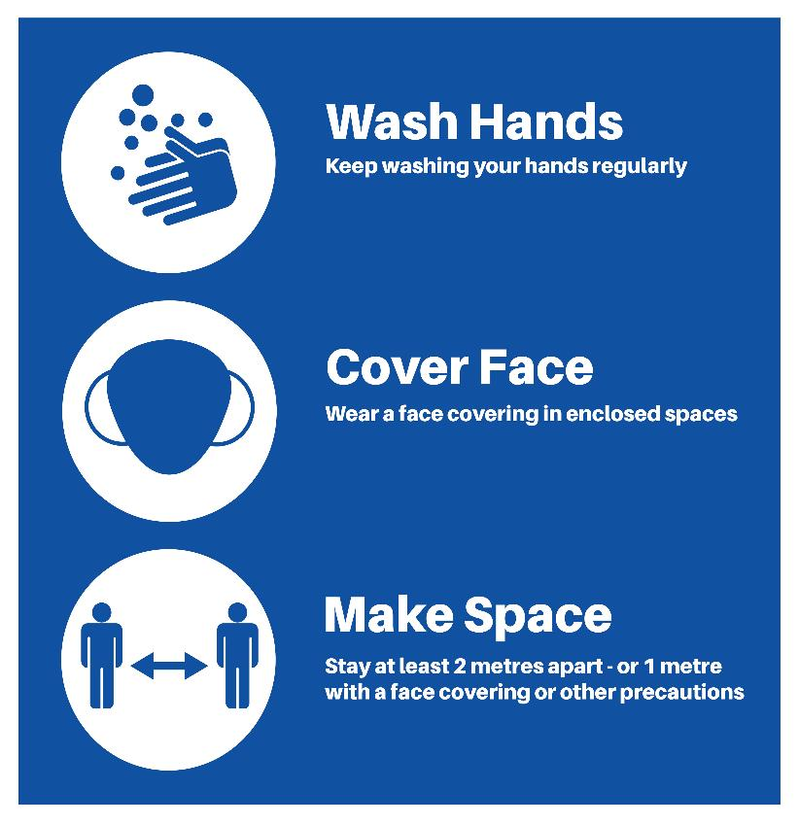
Risk assessment
Mitigating risks
The SPR model is often used at the risk assessment stage.
It can also be used to identify targeted actions to protect health and the environment (see right).
Jon Le-Bon/adobe.stock.com

Slide 6
Activity 1
Read the handout:
The source-pathway- receptor model

Slide 7
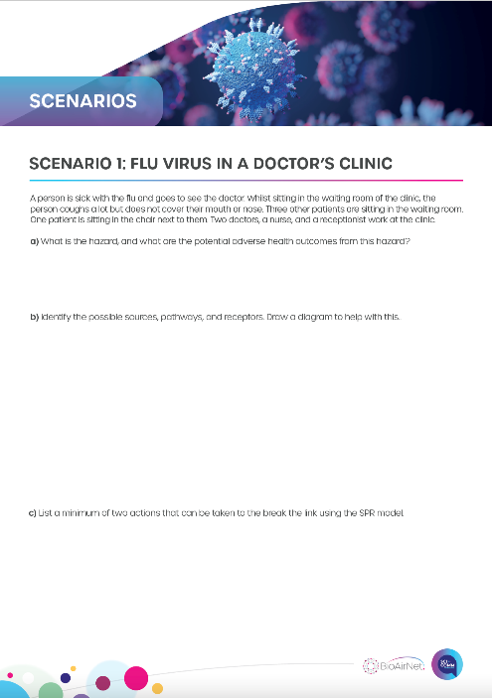
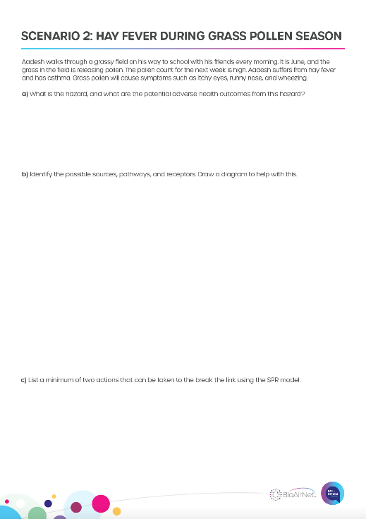
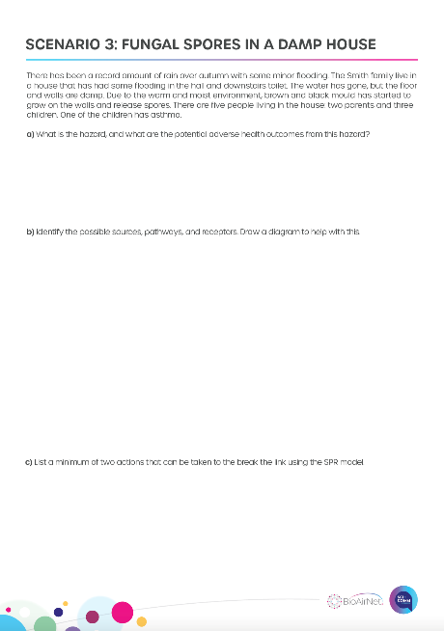
Activity 2
You will be given three scenarios. For each scenario:
Identify the hazard.
Identify the possible sources, pathways, and receptors. You may want to draw a diagram.
List a minimum of two actions that can be taken to the break the link using the SPR model.

