Slide 2
What is epidemiology?
Irina Strelnikova/stock.adobe.com
Epidemiology is the study of how diseases affect the health and illness of a population.
It aims to identify risks that make you more susceptible to disease and can be used to suggest actions to lower risk such as changing what you eat, your behaviour or your habits.
The information in this PPT is adapted from https://kids.kiddle.co/Epidemiology.

Slide 3
An example of epidemiology
Some epidemiologists notice that a large number of people are developing lung cancer.
They design a study to understand what these people are being exposed to see if there are any common factors amongst individuals.
They find that a significant number of these people smoke cigarettes or are exposed to cigarette smoke on a daily basis.
SurfupVector/stock.adobe.com

Slide 4
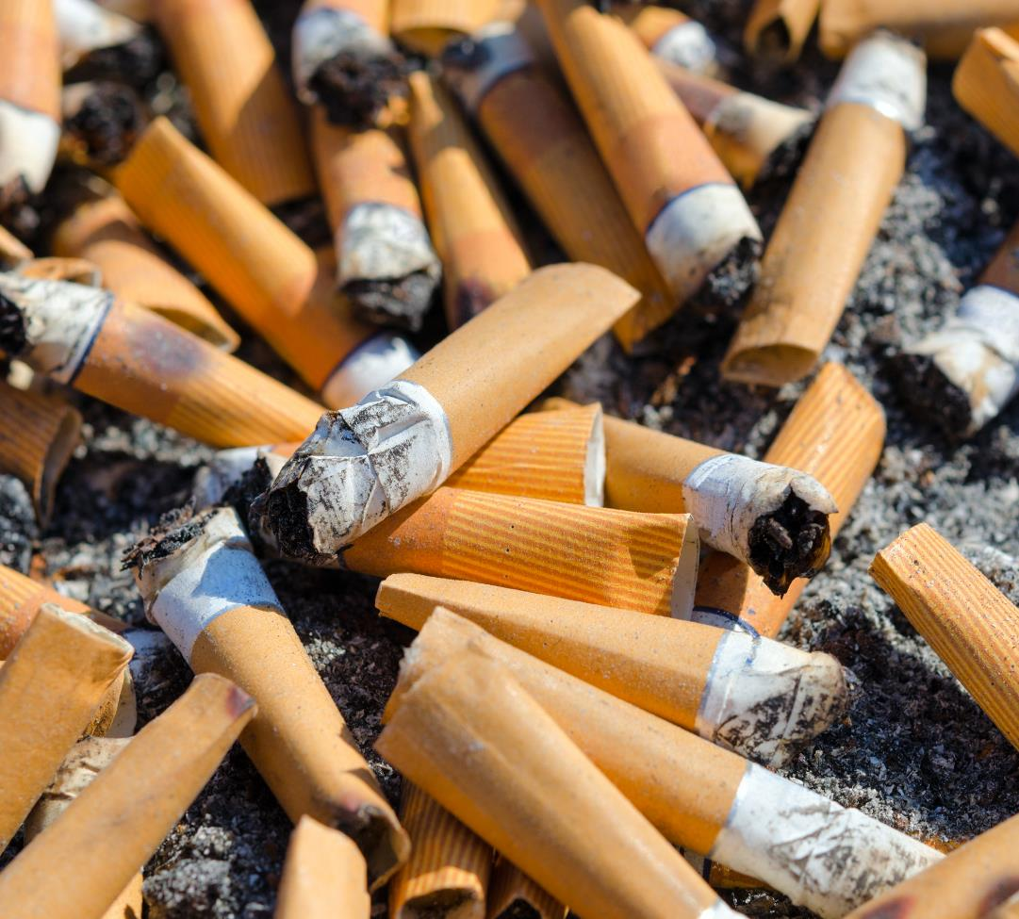
From this, the epidemiologists can conclude that smoking or being exposed to cigarette smoke may increase your risk of developing lung cancer.
We can now advise people what the risks are from smoking and suggest that they may want to stop.
However, exposure is often far more complicated, and epidemiologists need to be careful how they design studies and interpret the results to make sure they truly understand what causes disease.
Olga355/stock.adobe.com

Slide 5
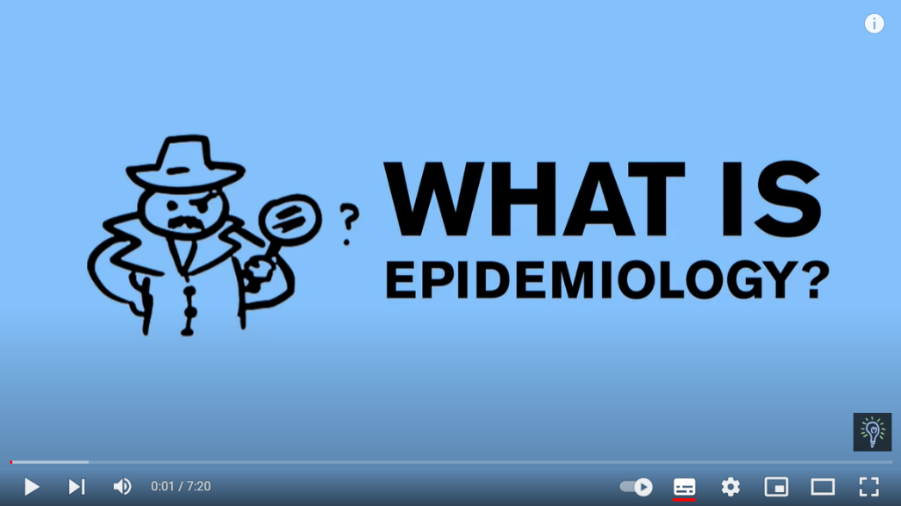
Activity 1
Epidemiology is an important science that can help us make healthier decisions.
Watch this YouTube video that explains what epidemiology is.

Slide 6
Activity 2
Conduct your own epidemiological investigation

Slide 7
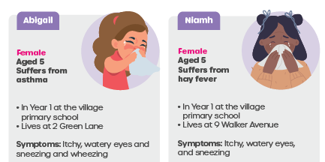
Villager cards
You will be given a card that provides key information about where a villager lives, works or studies.
The card will also contain characteristics i.e., sex, age, and health status, and any symptoms they may have experienced.

Slide 8
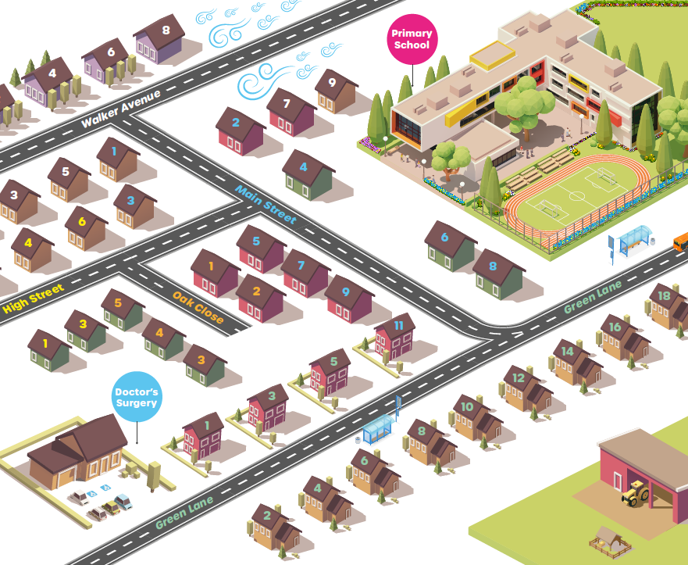
Map out where the villagers with symptoms live, work or study to determine the source of these symptoms. Answer these questions:
What is the source of the symptoms?
Where are the hotspots (places where people are experiencing symptoms)?
What are the three groups of symptoms?

Slide 9
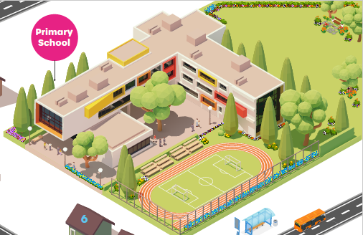
What is the source?
The newly planted wildflower meadow is the likely cause of the symptoms.

Slide 10
Where are the hotspots?
The primary school, specifically the Year 1 classroom.
The bus stops next to the wildflower meadow.
The houses nearest to the wildflower meadow.

Slide 11
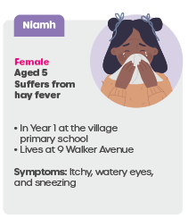
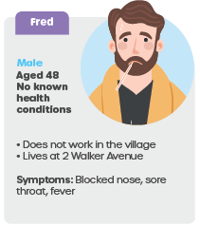
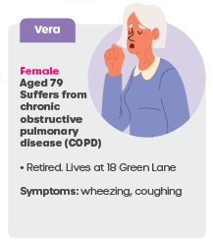
What are the three different groups of symptoms?
Itchy and watery eyes and/or sneezing
Wheezing and/or coughing
Blocked nose, sore throat, and fever

Slide 12
Group A’s symptoms are associated with allergy, especially those who suffer from hay fever.
Group B’s symptoms are associated with allergy and asthma or other respiratory conditions such as COPD.
Group C’s symptoms are not associated with allergy and are more likely associated with an infection.
A
C
B

Slide 13
Extension activity Can you identify people with certain conditions that put them more at risk of experiencing symptoms? This will require calculations to determine if those with health conditions are more likely to suffer from symptoms.
Of the 85 people living in the village, 25% suffer from a respiratory condition such as asthma, hay fever or COPD.
Therefore, 21 people have respiratory conditions and 64 people do not

Slide 14
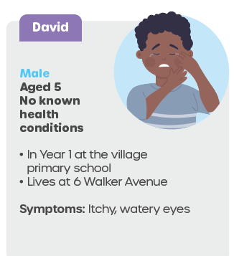
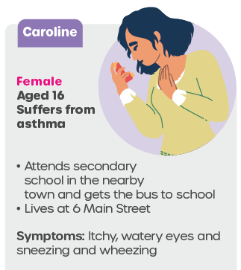
15.6% of villagers with no known conditions are likely to experience symptoms (10/64) and 76.2% of villagers with respiratory conditions are likely to experience symptoms (16/21).
Villagers with respiratory conditions are more likely to experience symptoms than those without health conditions.

Slide 15
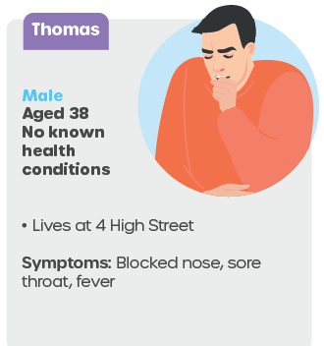
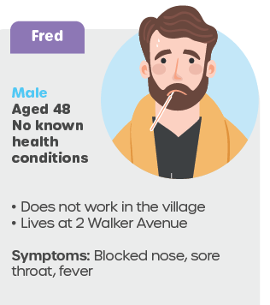
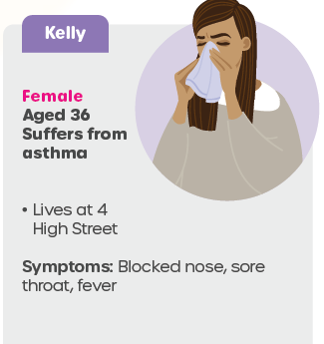
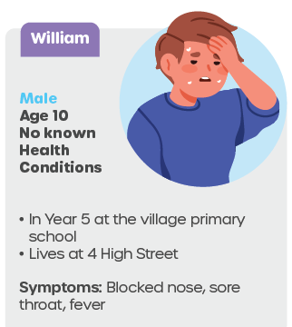
Of the 26 patients with symptoms (minus the four red herring patients), 10 do not have any known health conditions and 16 suffer from a respiratory condition.
Therefore, 21 people have respiratory conditions and 64 people do not

