Slide 2
Activity 1
Negative | Positive
What are the positive and negative effects of breathing in bioaerosols?
Discuss and fill in the table.

Slide 3
Positive | Negative
Exposure to bioaerosols allows us to build immunity to bacteria, fungi, and viruses | We can be exposed to microbes that can make us ill (i.e. cold, flu) or cause infection
 | We can be exposed to biological particles (pollen, fungus, dust) that can cause allergy – this can cause sneezing, wheezing and shortness of breath
 | We can be exposed to biological particles (fungus, pollen) that can cause sensitisation over time

Slide 4
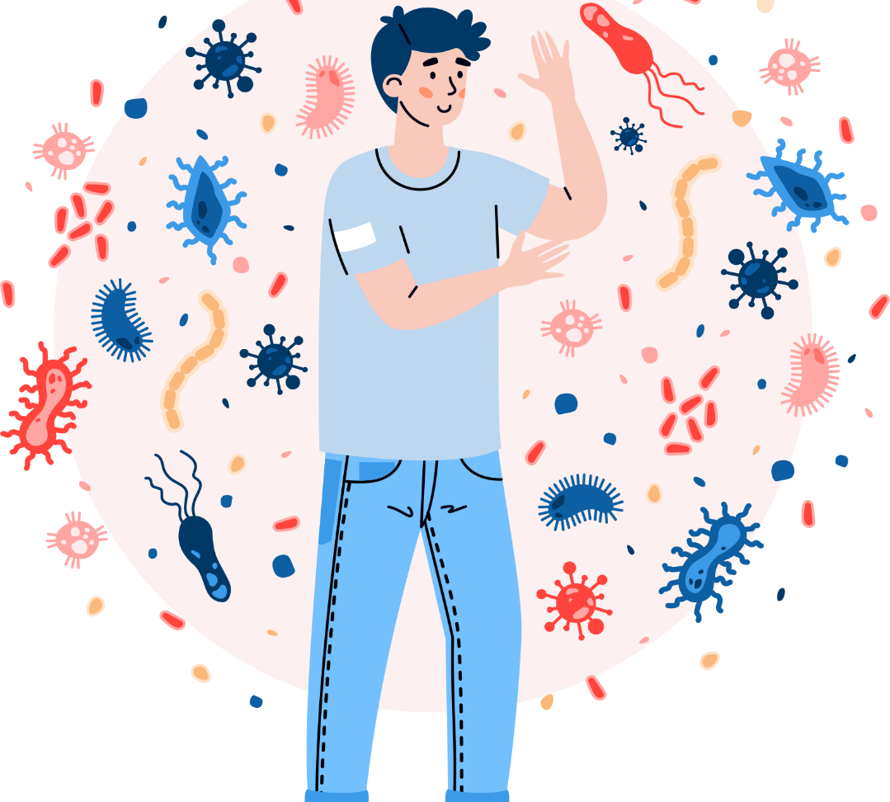
More about the positive effects…
Exposure to bioaerosols allows our immune systems to come into contact with a wide range of fungi, bacteria, and viruses.
This can allow our immune system to build up a defence against these microbes by producing antibodies, keeping us safe from serious infection.
Kudryavtsev/stock.adobe.com

Slide 5
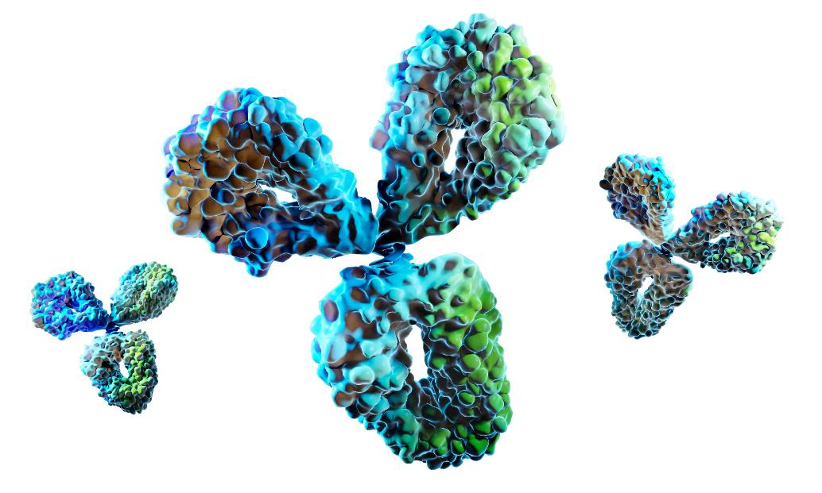
What is an antibody?
An antibody is a large, Y-shaped protein used by the immune system to identify and neutralise pathogenic bacteria, fungi, and viruses.
An antibody can tag a microbe or an infected cell for attack by other parts of the immune system.
peterschreiber.media/stock.adobe.com

Slide 6
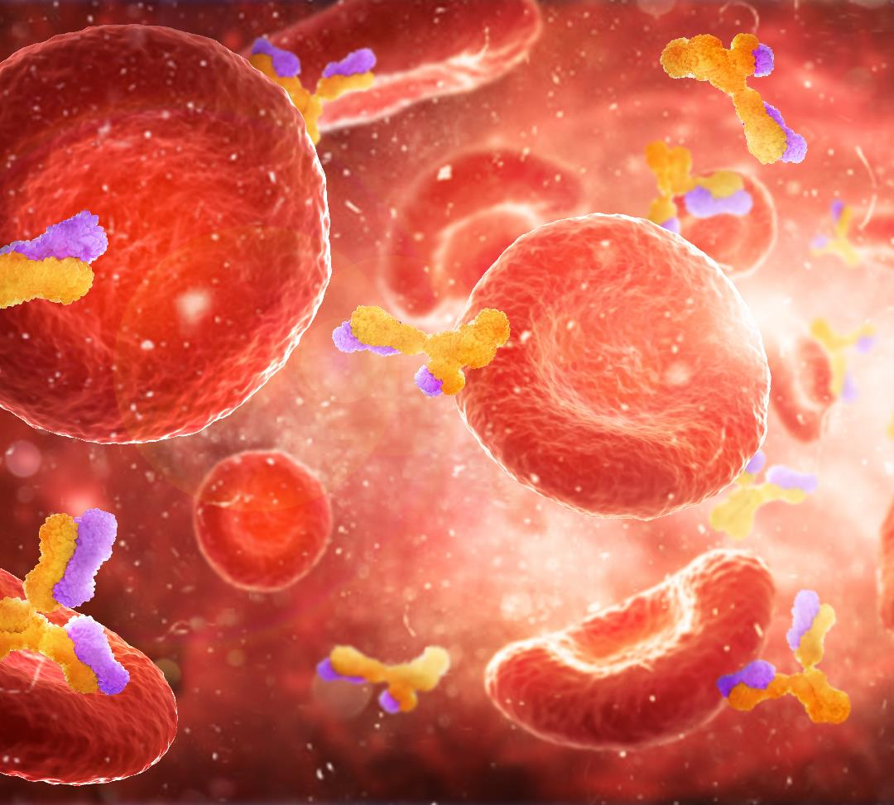
How do we build immunity?
Antibodies will then circulate in the blood for a prolonged period of time so that if someone comes into contact with that microbe or virus again, the immune system will respond quickly, preventing us from getting ill.
This is how we build immunity and exposure to components of bioaerosols can help us do this.
Vipman4/stock.adobe.com

Slide 7
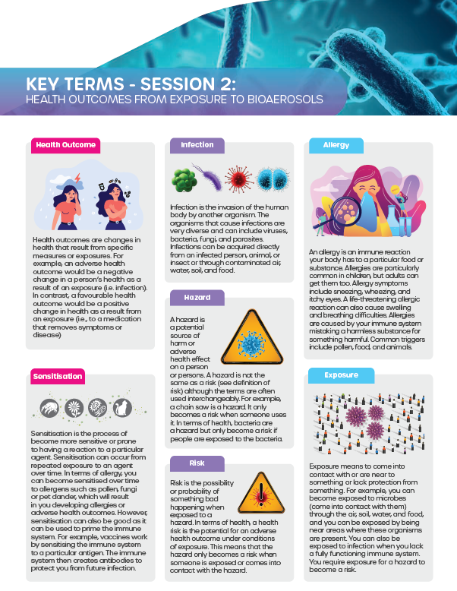
Activity 1
Read the Key Terms.
Describe what a health outcome is
Explain the adverse health outcomes that can develop from exposure to bioaerosols.

Slide 8
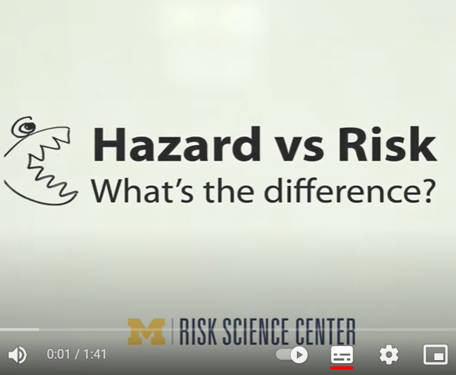
Activity 2
What is the difference between ‘hazard’ and ‘risk’?
Watch this YouTube video on the difference between hazard and risk.

Slide 9
How do we get from hazard to risk?
When dealing with hazards, the risk of harm occurring from that hazard only occurs under conditions of ‘exposure’.
This means that there must be a route between the hazard to the individual involved for the hazard to present a risk.
Bakhtiarzein/stock.adobe.com

Slide 10
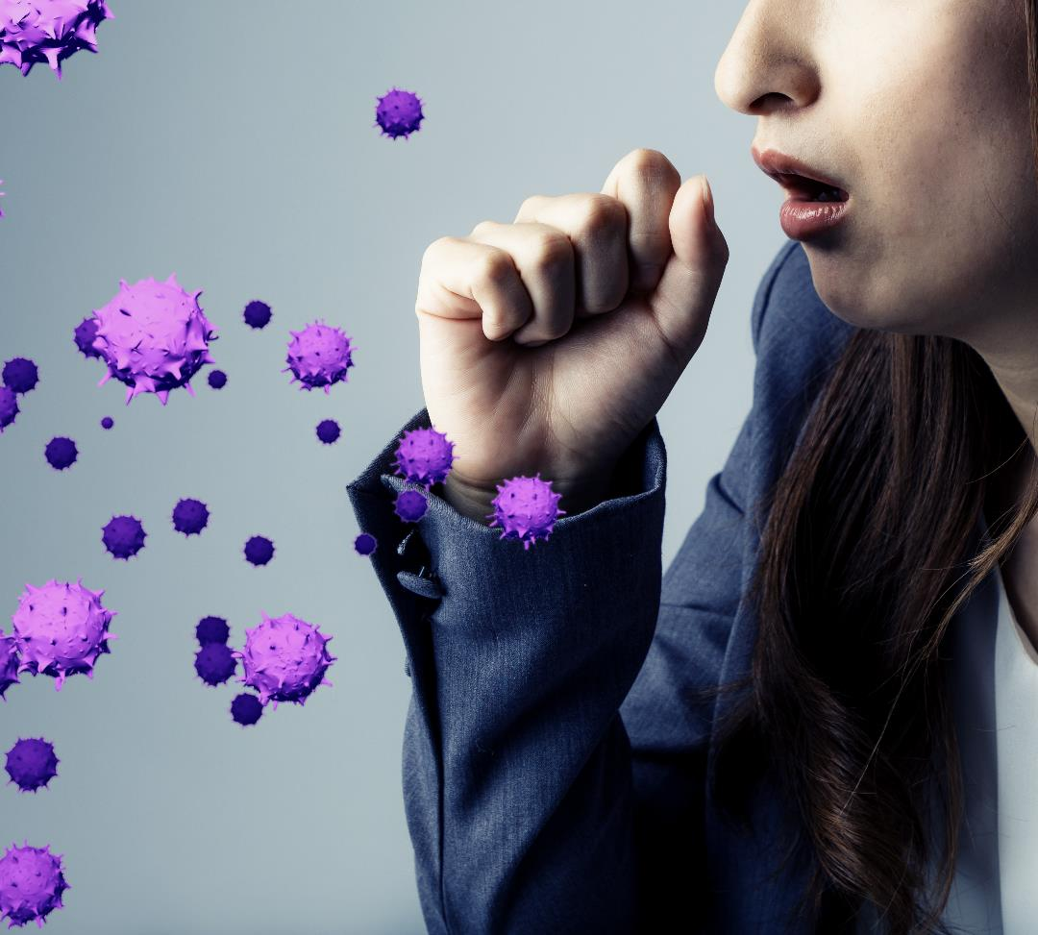
How do we get from hazard to risk?
A person with the flu may cough and this will produce a bioaerosol that contains hundreds to thousands of flu virus particles.
If the sick person coughs in a room where no one else is, then no one else has been exposed to the flu virus and risk of anyone else getting sick is LOW.
Metamorworks/stock.adobe.com

Slide 11
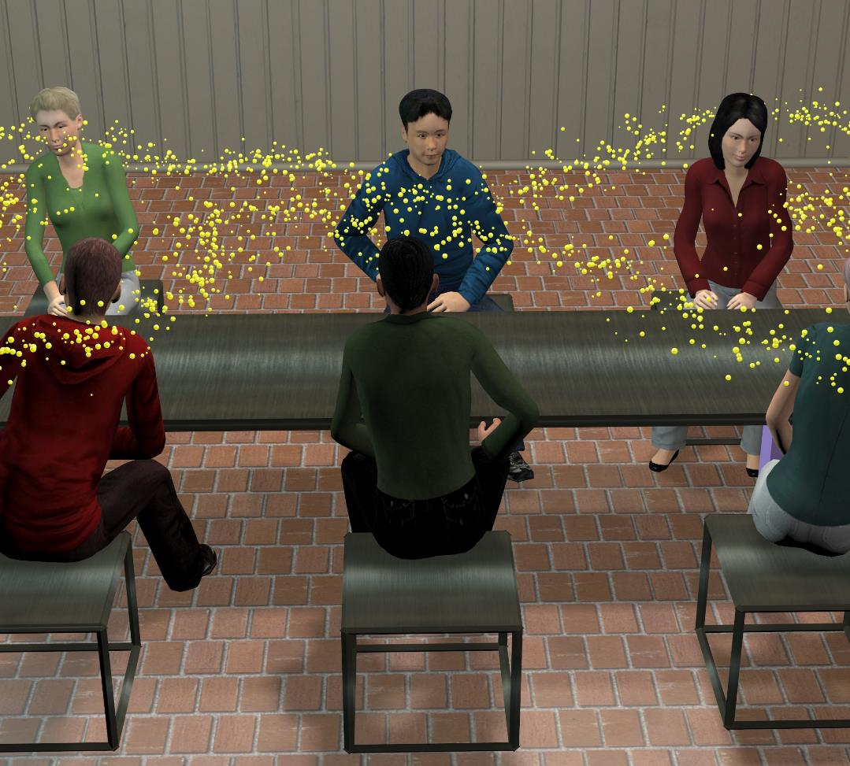
How do we get from hazard to risk?
If a healthy person is in the room when the sick person coughs, then the healthy person has been exposed to the flu virus.
This does not automatically mean the healthy person will get sick, but the risk of them getting sick is HIGHER because they have been exposed to the hazard (the flu virus).
Vrx123/stock.adobe.com

Slide 12
The meaning of ‘exposure’
What do you understand by the word ‘exposure’?
Exposure means: 'experiencing something or being affected by it while in a particular situation or place’.

Slide 13
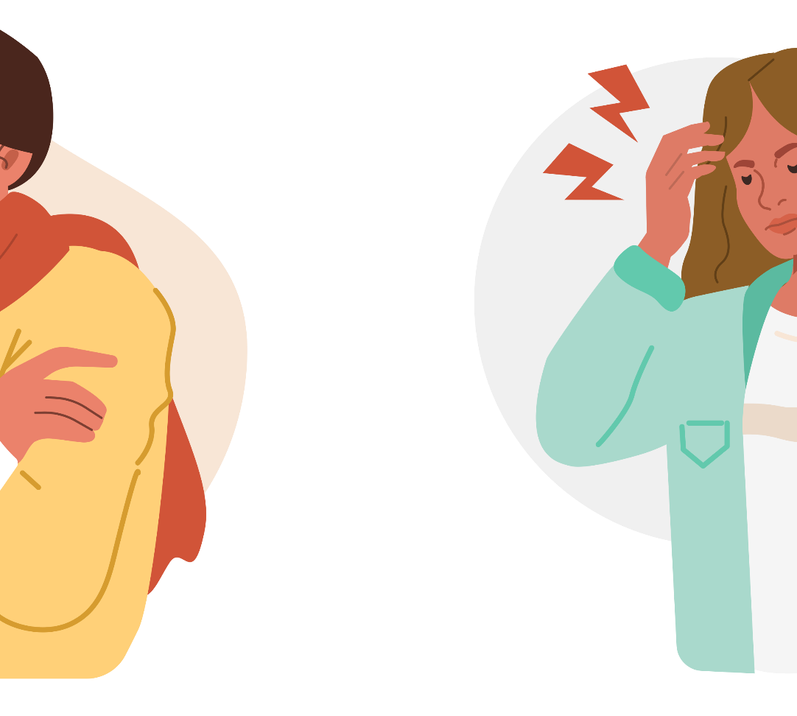
The meaning of ‘exposure’
If there is no exposure to a virus or bacteria, then the risk of infection is LOW. If there is exposure, then the risk is HIGHER.
For example, a person’s risk of catching COVID-19 is greater if they stand within 6 feet of a person with the virus for more that 15 minutes.
Irina Strelnikova/stock.adobe.com

Slide 14
Activity 3
Choose a bioaerosol and describe the adverse health outcomes that can potentially come from that bioaerosol.
You might like to draw a diagram to present these health outcomes.
Prostock-studio/stock.adobe.com

