Slide 2
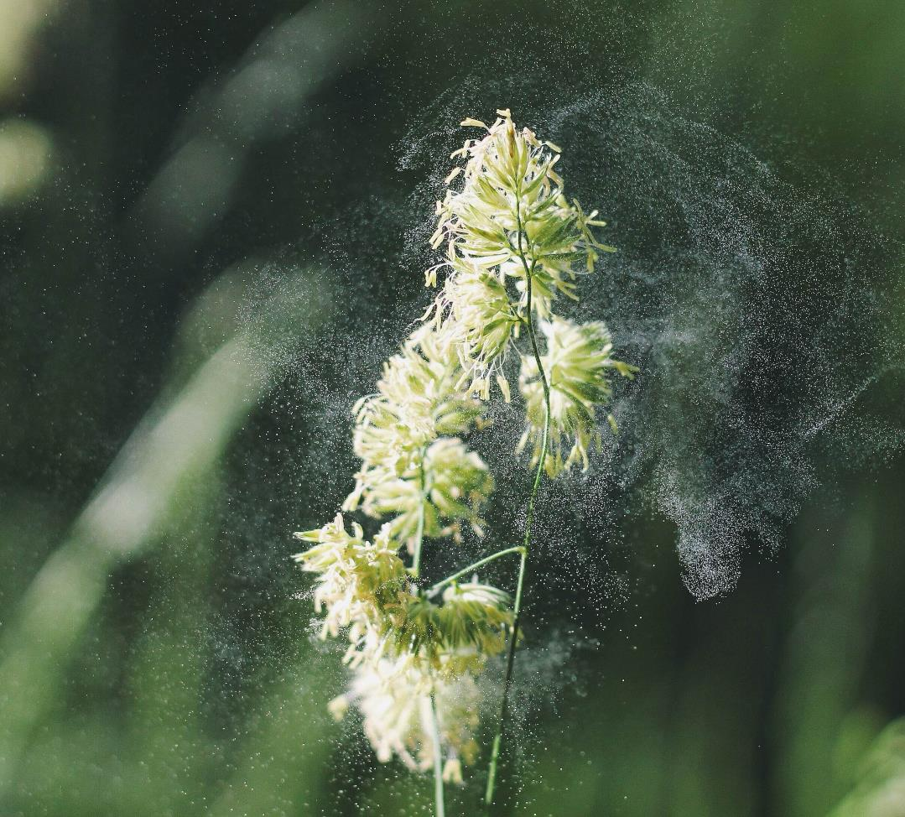
To recap…
What are bioaerosols?
Bioaerosols are particles of biological origin that are present in the air we breathe.
They consist of both living and non-living components, such as fungi, pollen, bacteria, and viruses.
Common sources of bioaerosols include soil, water, and sewage plants.
Unsplash: Alex Jones

Slide 3
Activity 1
Watch the animation:
Introduction to the respiratory and immune system

Slide 4
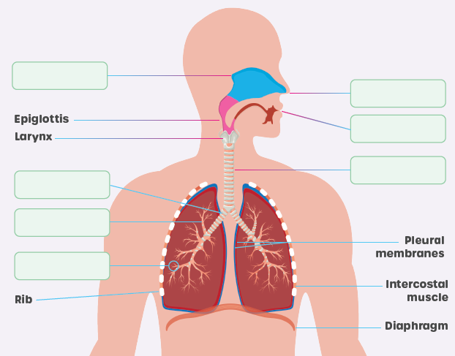
Activity 2
Fill in the gaps on the Activity Sheet:
The respiratory system

Slide 5
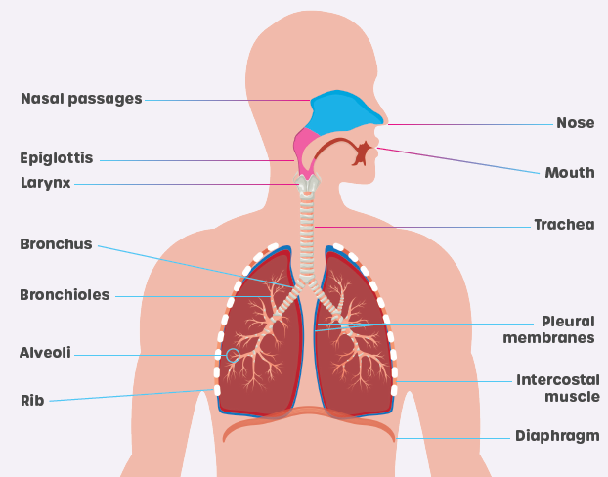
Eveleen007/stock.adobe.com

Slide 6
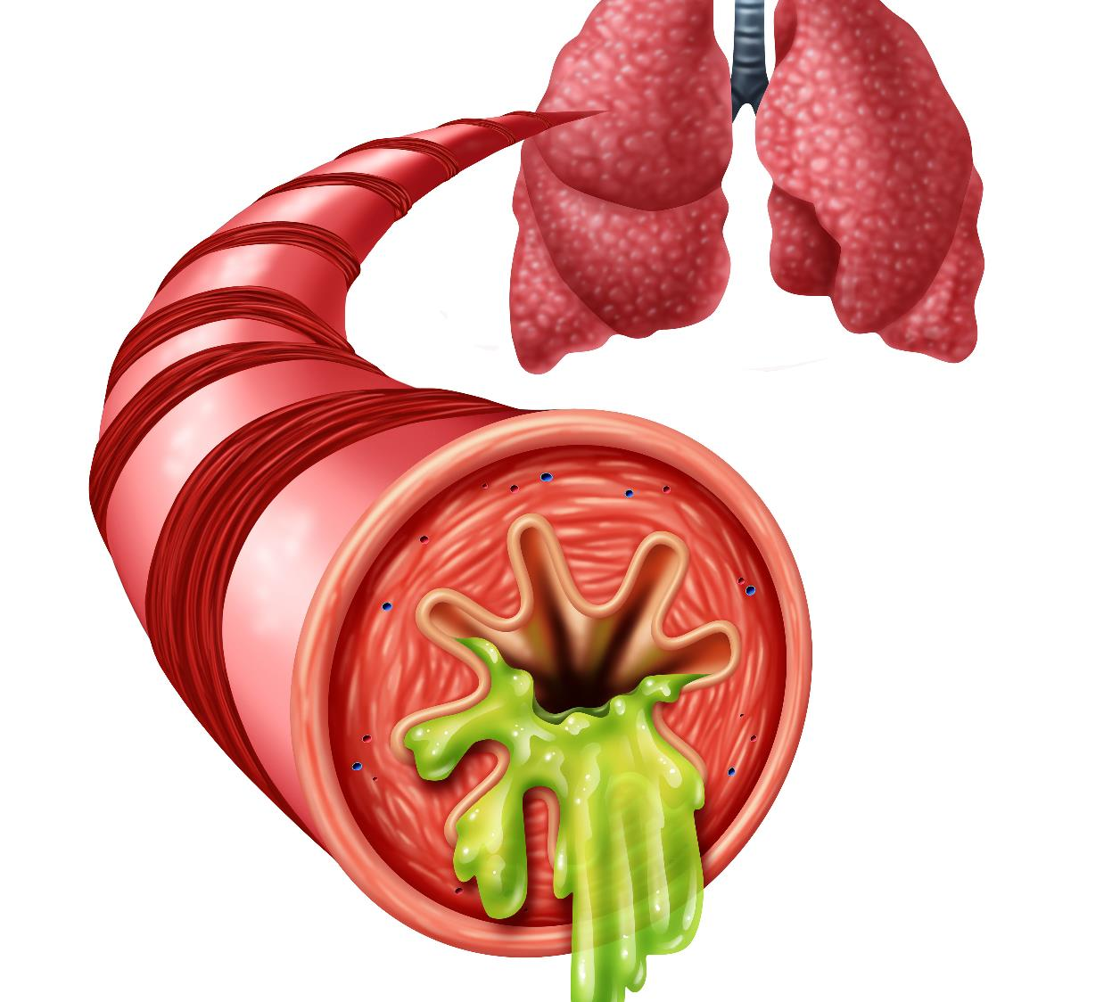
In the lungs…
There are mechanisms that help get rid of foreign particles and microbes that can cause ill health.
The lungs contain goblet cells which produces a sticky mucus that lines the trachea and bronchi.
This mucus traps foreign particles.
freshidea/stock.adobe.com

Slide 7
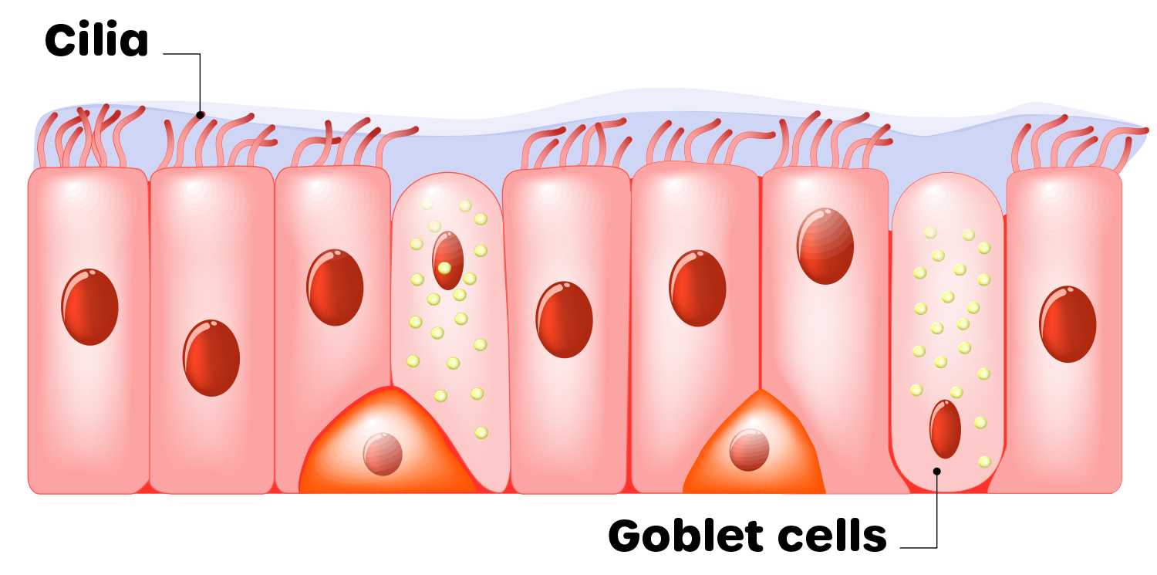
As well as goblet cells…
The lungs contain cilia, cells which have hair like protrusions on their surface.
The cilia beat or move at a certain frequency creating an ‘escalator’. This moves the mucus containing foreign particles up from the lungs into the throat, where it can be coughed up or swallowed.
We often refer to this as phlegm.
Unsplash: Alex Jones
designua@stock.adobe.com

Slide 8
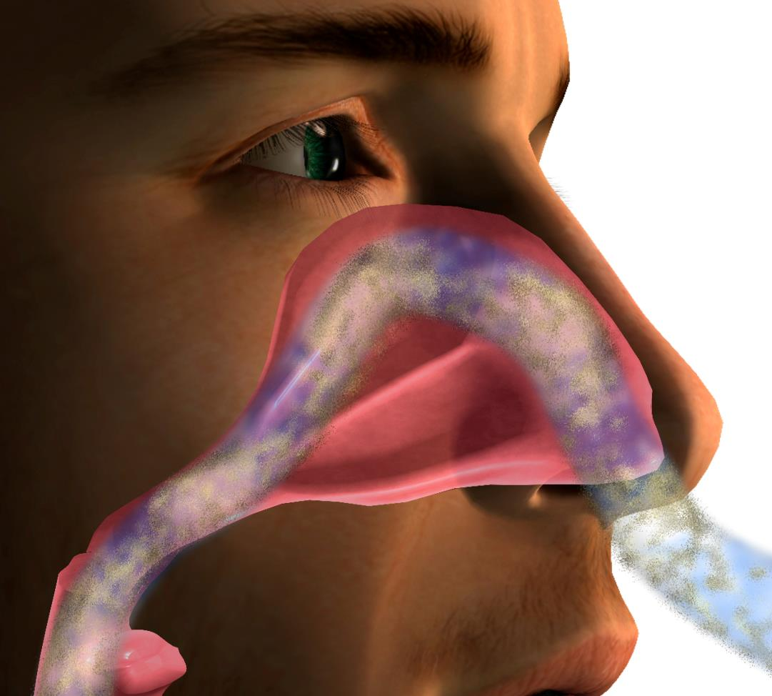
Within the nose and nasal passages…
Hank Grebe/stock.adobe.com
Mucus is produced, which catches foreign particles.
We also have hairs in our nose which help trap these particles.

Slide 9
When these particles get trapped…
… it can initiate the process of sneezing, which expels the foreign particles with force out of the nose and mouth.
When we are infected by foreign particles, more mucus is produced leading to a ‘runny nose’.
Unsplash: Alex Jones
Visual Generation/stock.adobe.com

Slide 10
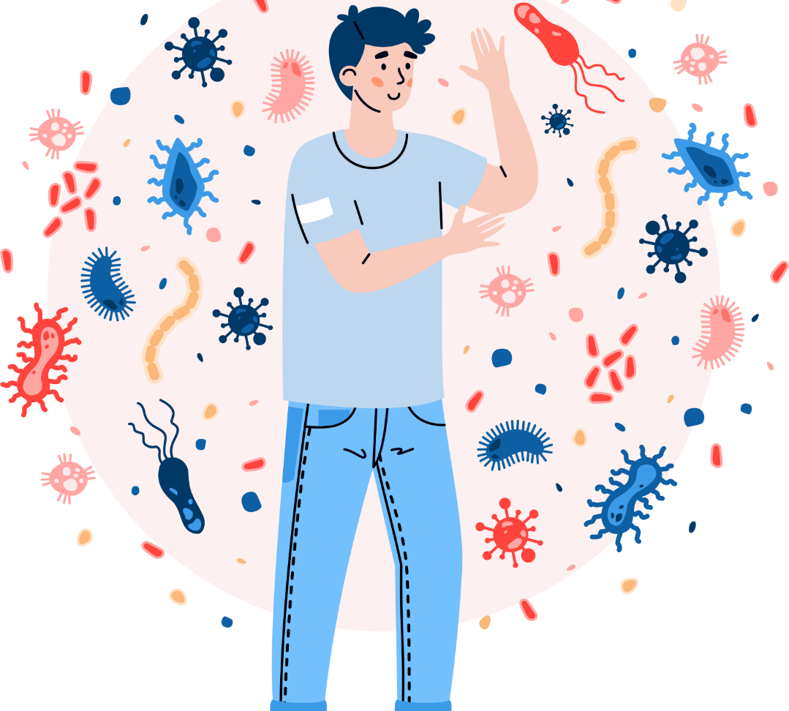
The immune system
Our body contains an immune system which is a collection of tissues and cells designed to attack and remove foreign particles, such as microbes and viruses, and protect us from infection.
The immune system has two parts called ‘innate’ and ‘adaptive’.
Unsplash: Alex Jones
Kudryavtsev/stock.adobe.com

Slide 11
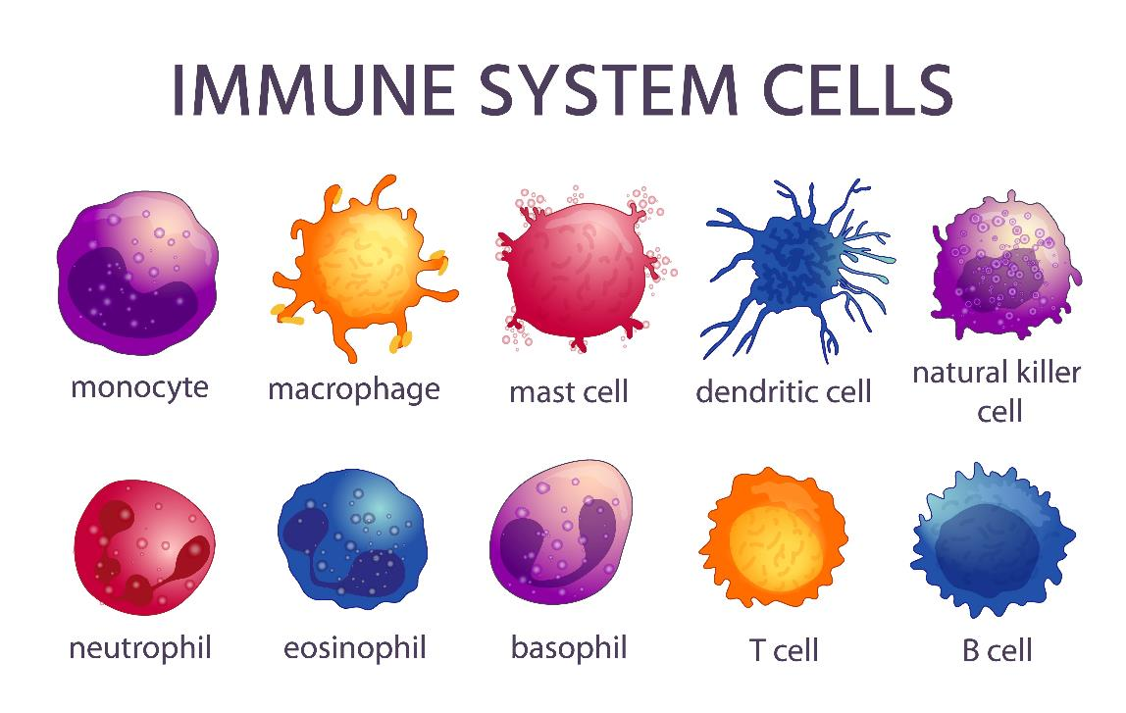
Innate immune system
The innate immune system is our first line of defence against foreign microbes.
The innate immune system is able to tell the difference between our own cells and the foreign microbes and, when they are detected, mount a response straight away using specialised cells within our body.
Tartila/stock.adobe.com
Unsplash: Alex Jones

Slide 12
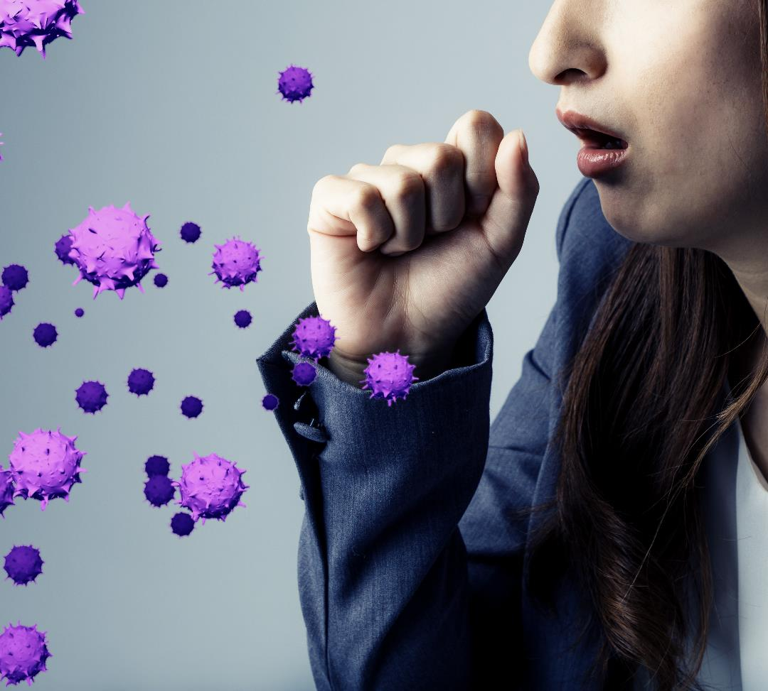
The innate immune system will start working as soon as foreign particles are detected.
It is responsible for some of the common symptoms of infection, including fever (raising the body’s temperature to kill the microbes), and sneezing and coughing (to expel foreign microbes out of the body).
Metamorworks/stock.adobe.com

Slide 13
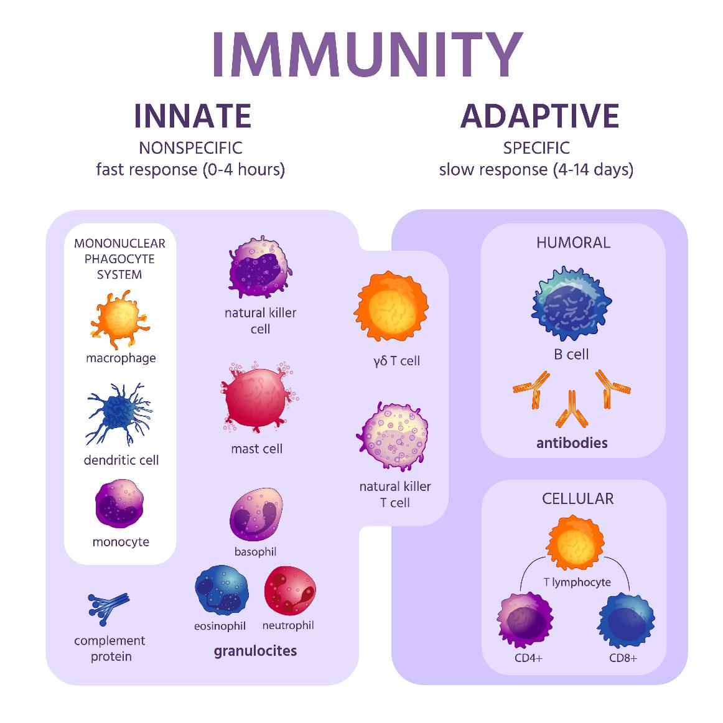
Adaptive immune system
Tartila/ stock.adobe.com
The adaptive immune system is the part responsible for producing antibodies to specific microbes and viruses.
The cells in the innate immune system will present parts of the foreign microbes to the adaptive immune system, which will then start producing antibodies.
The adaptive response is slower than the innate response, so we have both to ensure that our body can start fighting infection straight away.
Unsplash: Alex Jones

Slide 14
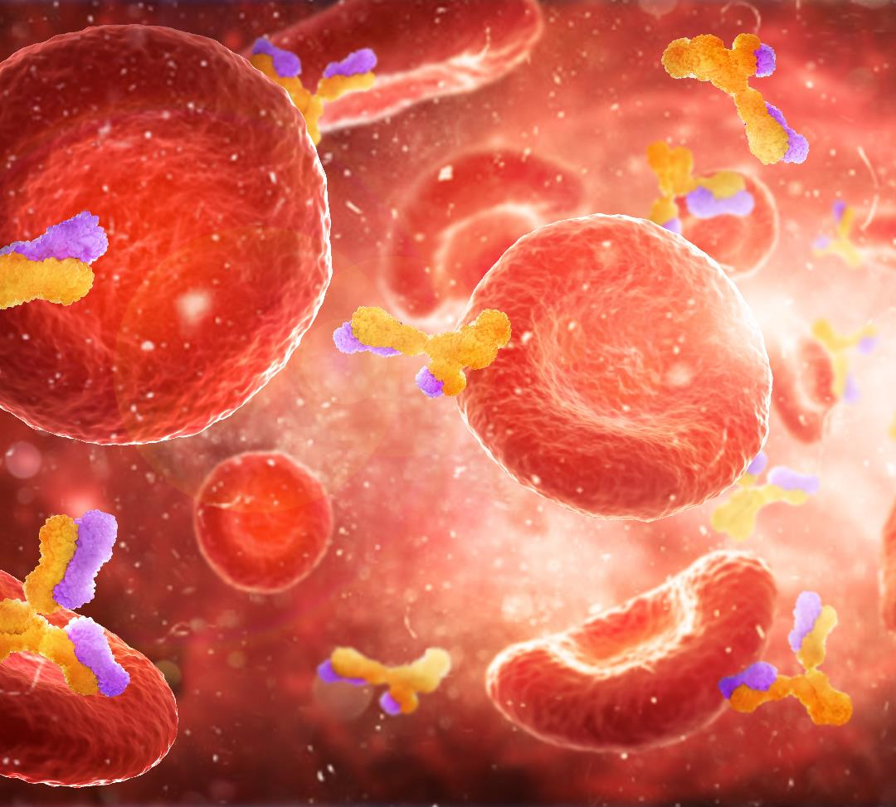
Antibodies
The antibodies work by tagging the microbes or viruses for destruction by immune cells.
These antibodies then stay in our blood for a prolonged period of time and can recognise the microbes as soon as they enter the body again, preventing us from getting ill a second time.
Vipman4/stock.adobe.com

Slide 15
Plenary
1. What did you already know before this session?
2. List three new things you have learned.
3. What fact or piece of information surprises you the most?
4. In what way has this session changed the way you see the world or your body?

