Slide 2
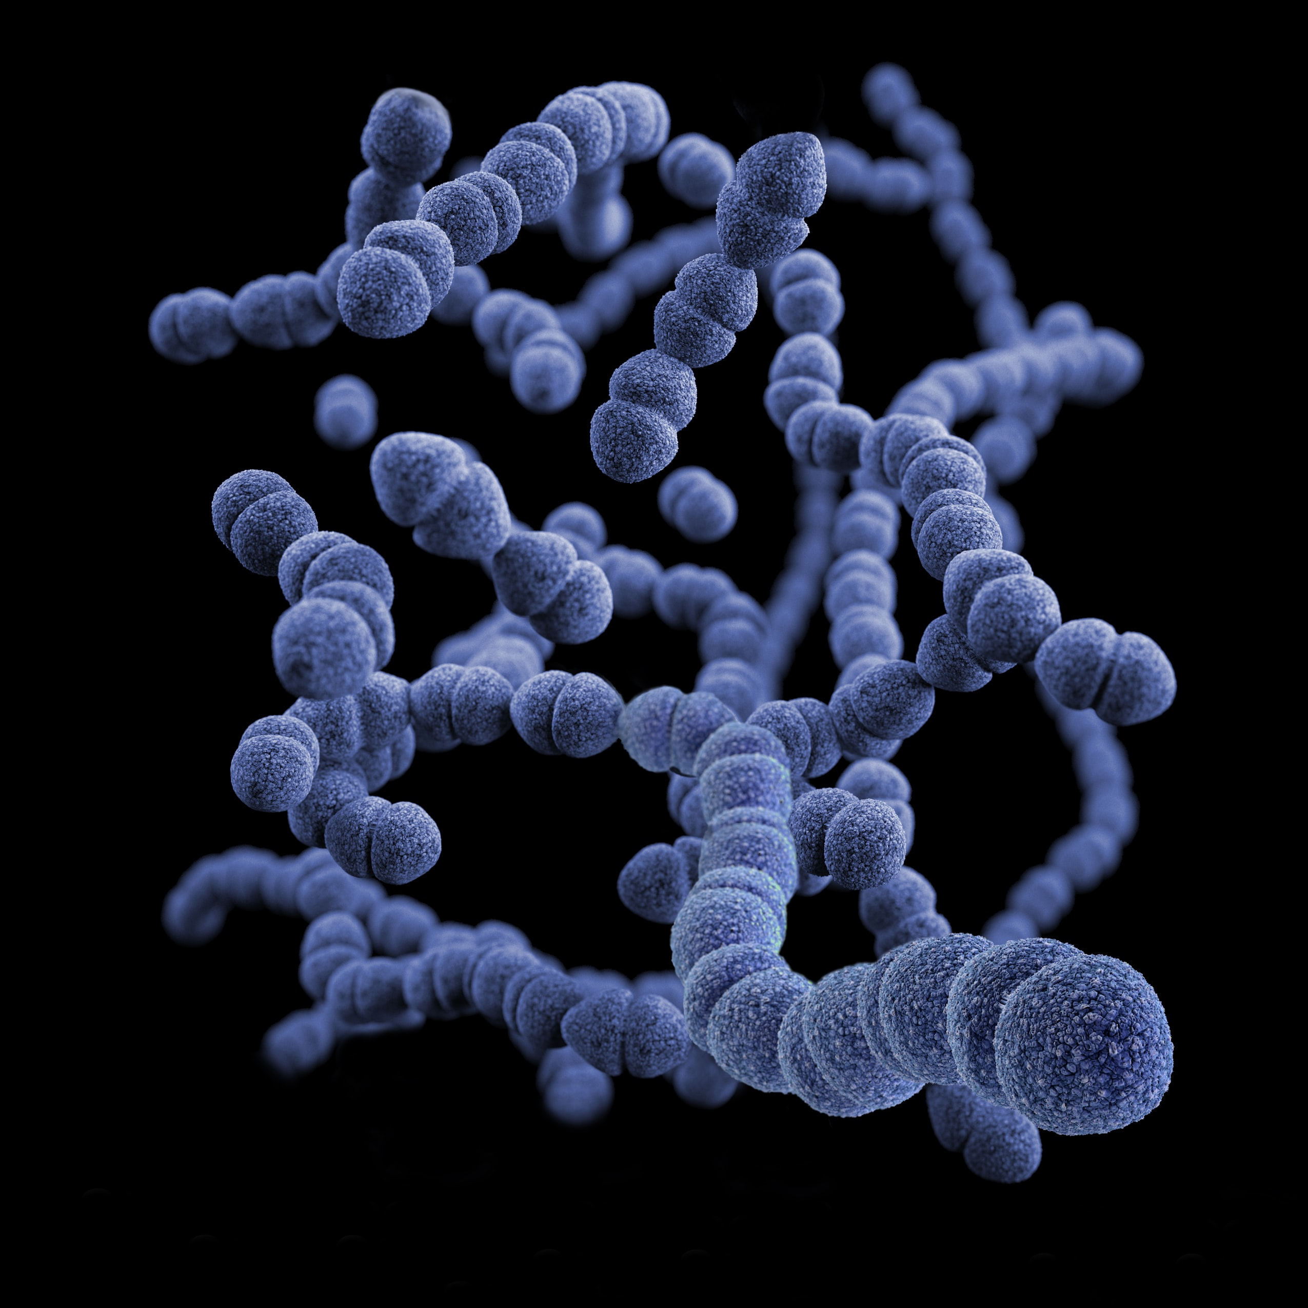
Microorganisms are microscopic organisms
They can be found in the three domains of life:
Bacteria, archaea and eukaryota
Bacteria and archaea are prokaryotes, very simple organisms that do not have a nucleus
“pro” means “before” and “karyotes” means “nucleus”
Gram-positive, Streptococcus pneumoniae bacteria (Unsplash: CDC)

Slide 3
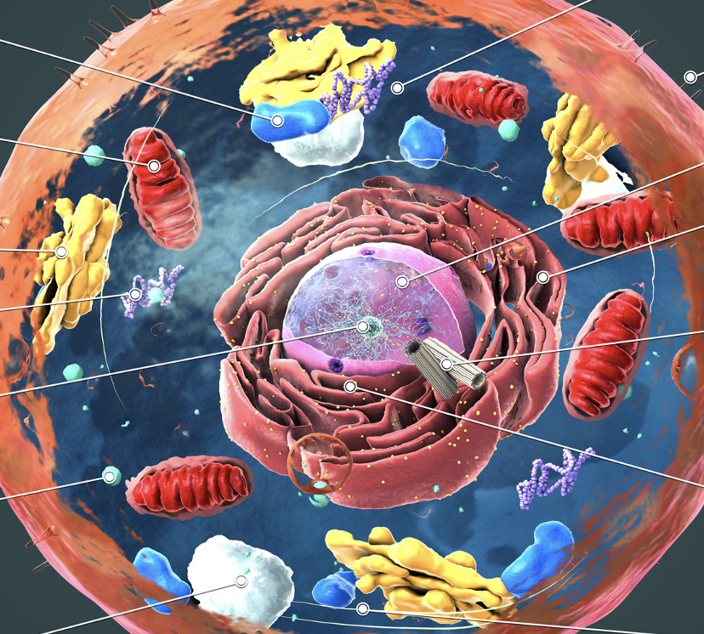
Eukaryotes
Eukaryotes have very complex cells that contain a nucleus (a cellular structure where the genetic material is stored) …
…and other cell structures that allow these cells to perform complex functions

Slide 4
Adobe Stock Images: Christoph Burgstedt

Slide 5
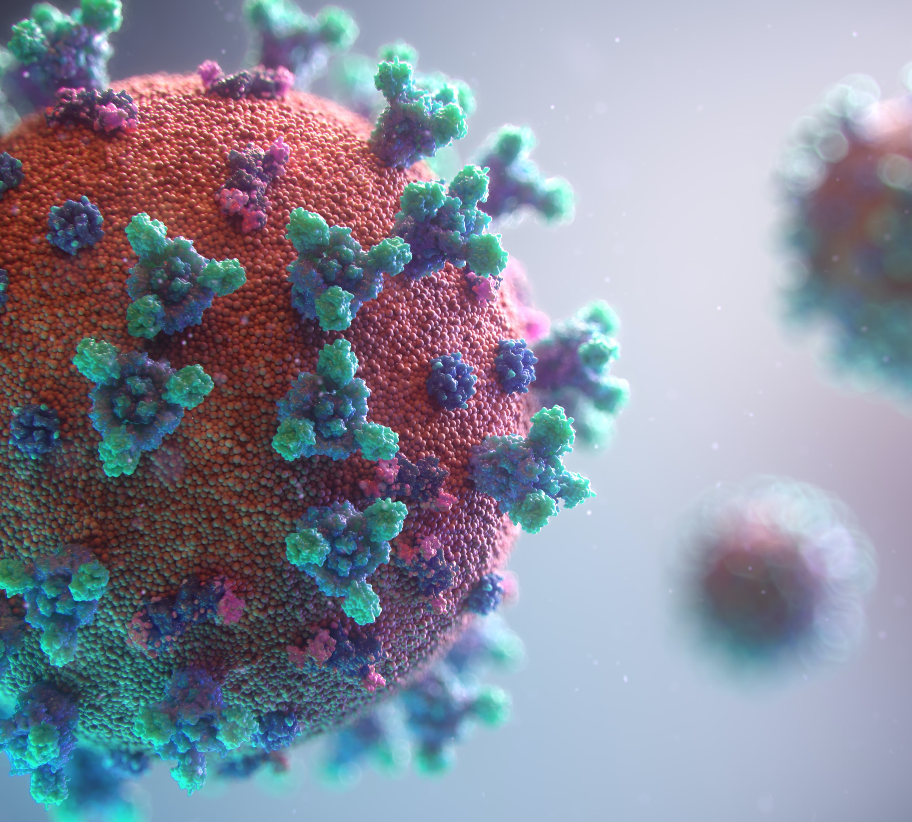
Viruses
Viruses are not classified as microorganisms
This is because viruses are not considered living entities, but rather genetic elements that can replicate only inside living cells…
…called host cells
Respiratory syndrome coronavirus (Unsplash: CDC)

Slide 6
Are bioaerosols harmful?
Although most bioaerosols are harmless, some contain microorganisms that are harmful to human health, known as pathogens
In addition to pathogens, bioaerosols may contain allergens or act as carriers of toxic components or metabolites
(Unsplash: Nathan Dumlao)

Slide 7
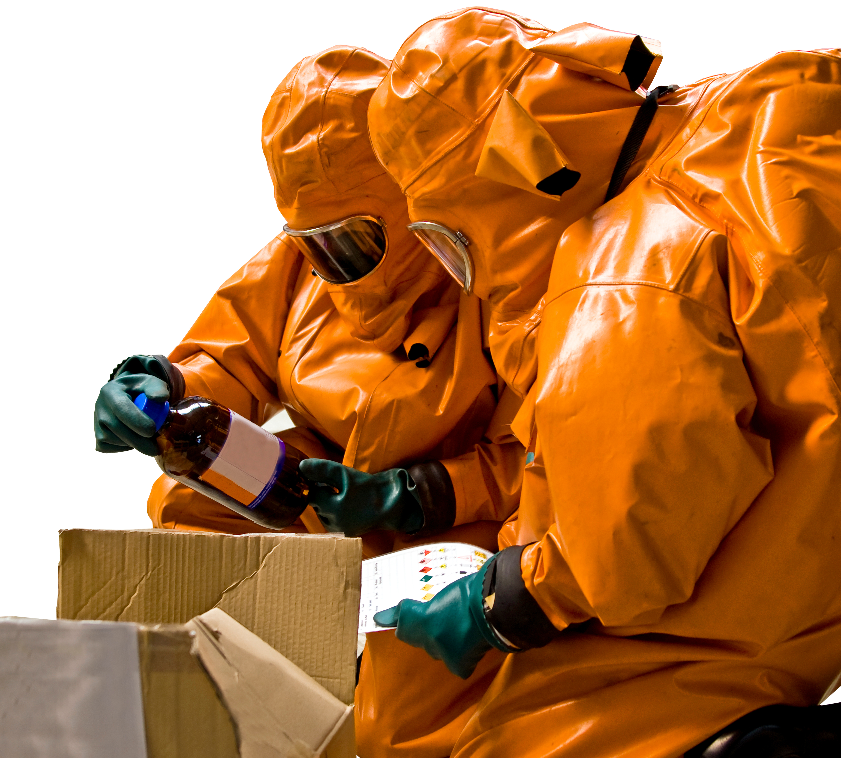
Are bioaerosols harmful?
Metabolism is the term used for all the chemical reactions that go on inside an organism's body
A metabolite is an intermediate or end product of metabolism
Bioaerosols have attracted much attention recently due to their potential impact on human health as well as the threat of bioterrorism
Adobe Stock Images: Sauerlandpics

Slide 8
Talking points
What is a microorganism?
Why aren’t viruses considered a microorganism?
What are allergens?
What is bioterrorism?
Are all microorganisms harmful? Name some that are.
List some microorganisms that aren’t harmful.

Slide 9
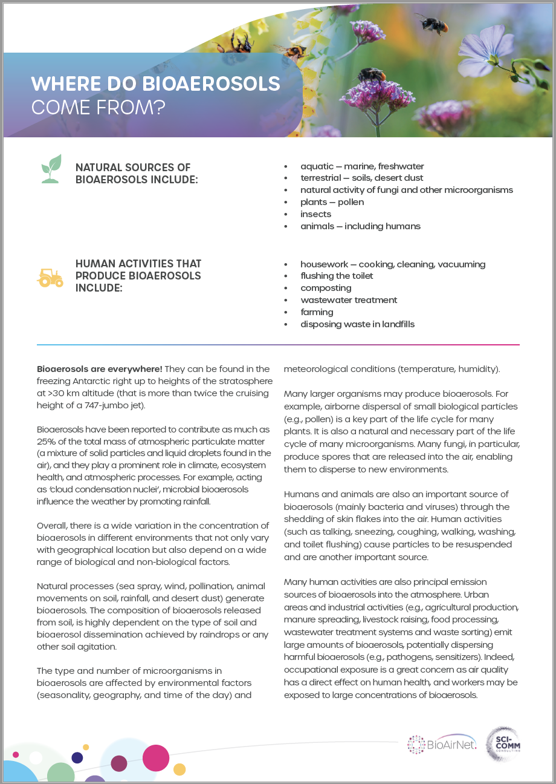
Activity 1
Read the handout:

Slide 10
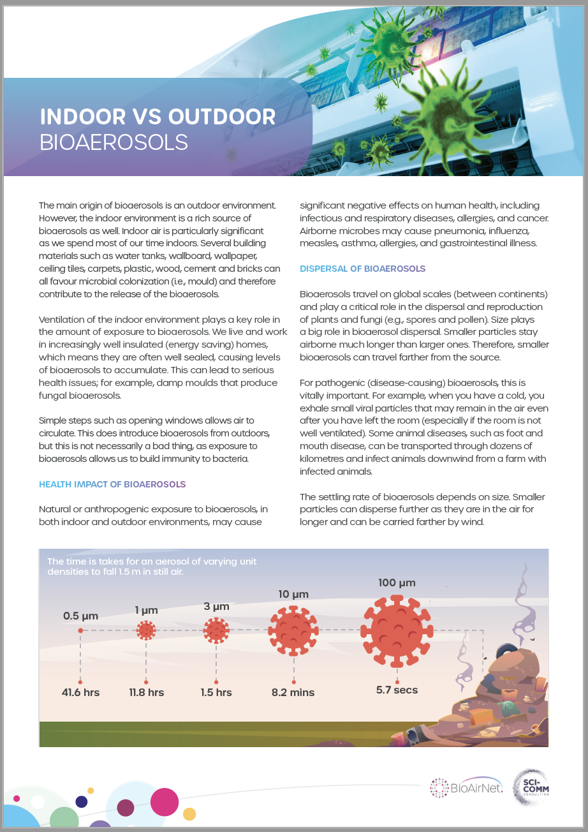
Activity 2
Read the handout:

Slide 11
Activity 3
Follow the instructions to:

Slide 12
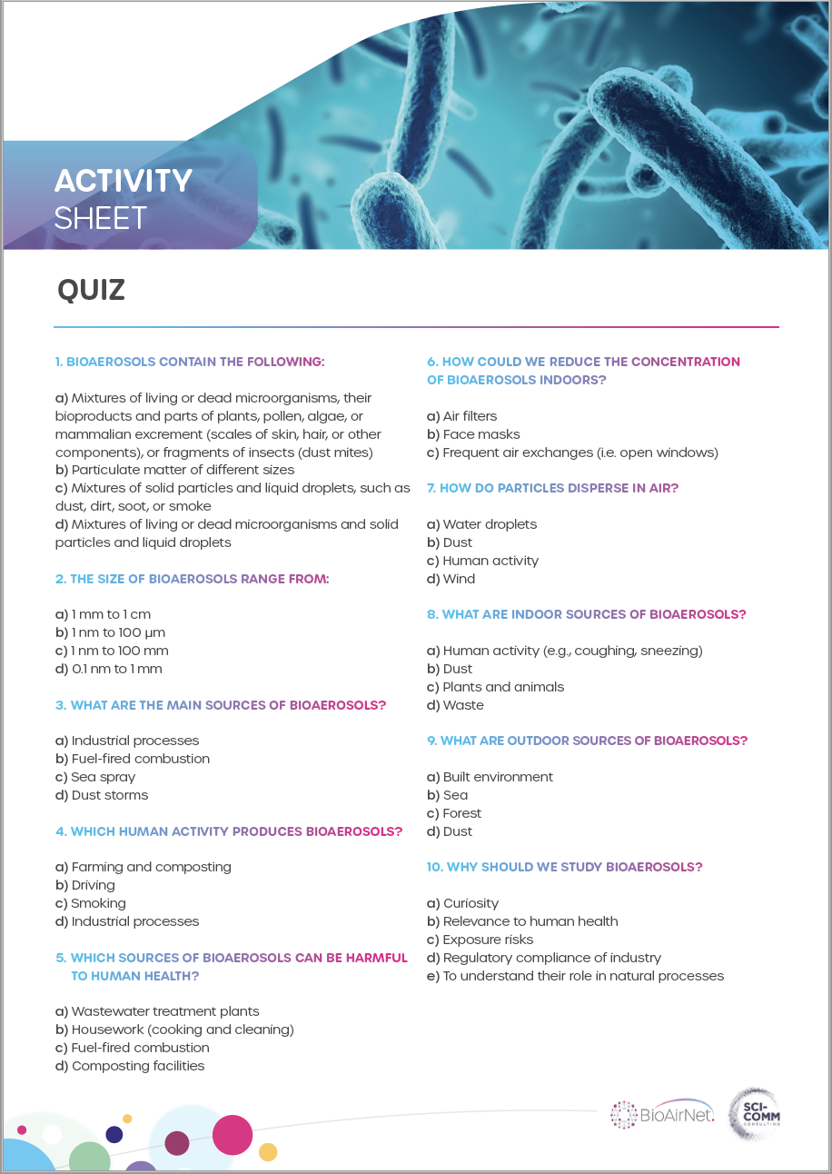
Activity 4
How can we reduce indoor bioaerosols?
Test your knowledge

